Slide 1
OPAMP APPLICATIONS

Slide 2
Op amp has countless applications and forms the basic building block of linear and non linear analog systems.
Linear applications: adder, subtractor, V to I converter, I to V converter, instrumentation ampr, etc
Non linear applications: rectifier, log & antilog ampr, multiplier, clipper, clamper, etc.

Slide 3
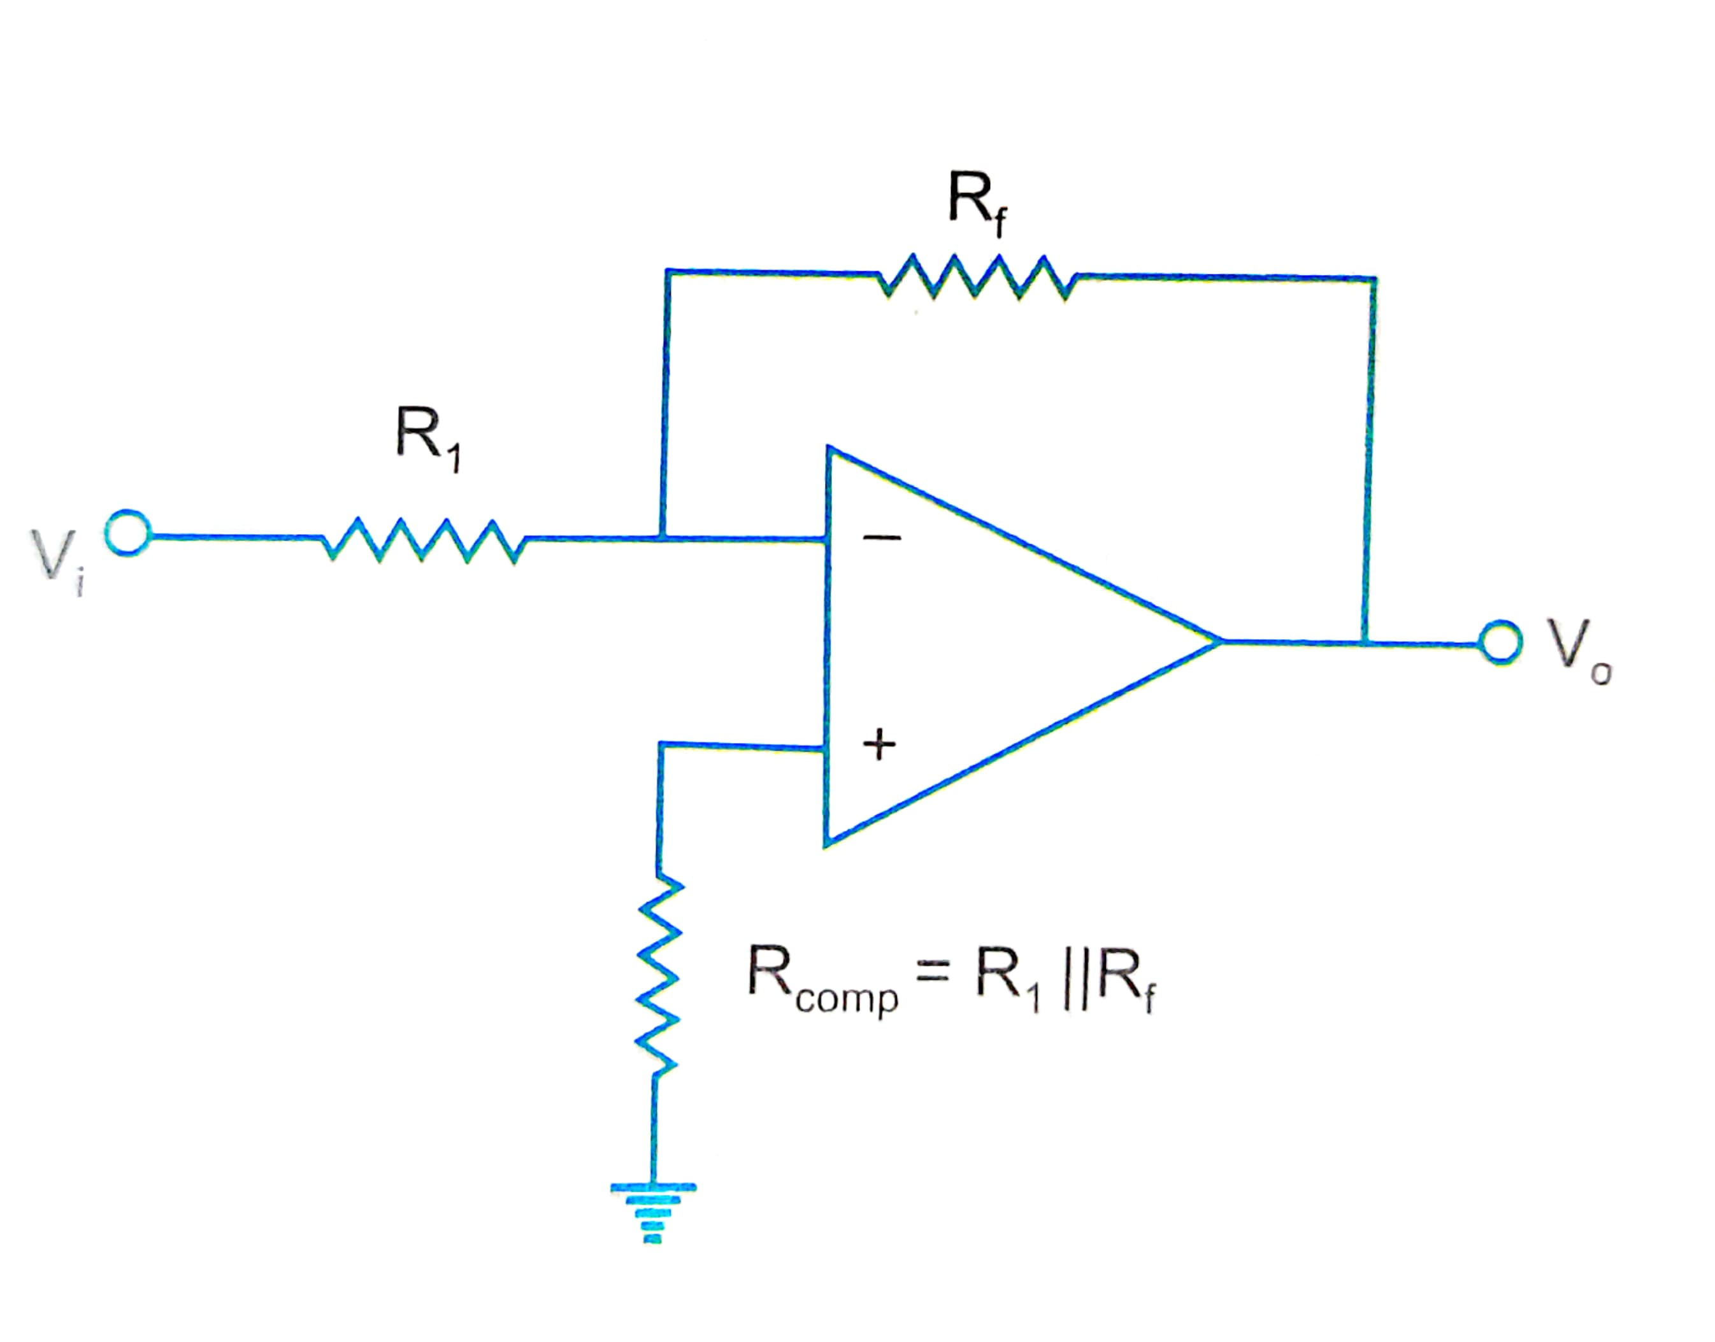
1.Basic op amp applications
a. Scale changer/inverter

Slide 4
R_{comp} is the compensation resistor used to compensate the effect of bias currents.
It is added btw non inverting input terminal & grnd.
To compensate bias current, R_{comp} should be
R_{comp} = R₁ ││R_{f}
In the basic inverting ampr, if ratio R_{f}/R₁=K, where k is a real constant,
Then CL gain A_{CL} = -K.
The ckt thus could be used to multiply by a constant factor if R_{f} and R₁ are selected as precision resistors.
For R_{f}=R₁, A_{CL} =-1 . This ckt is called an inverter.
That is, o/p is 180 deg out of phase wrto i/p, though the magnitudes are same.

Slide 5
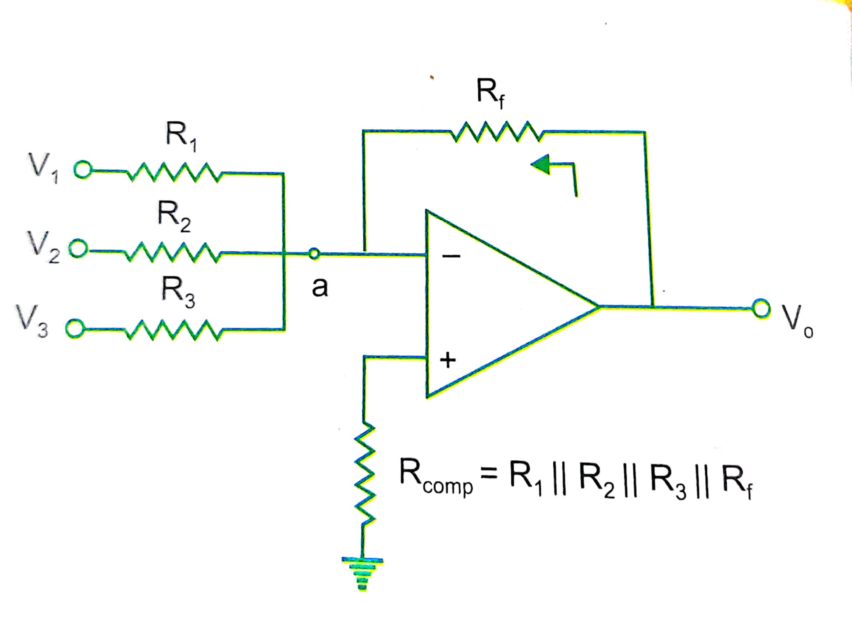
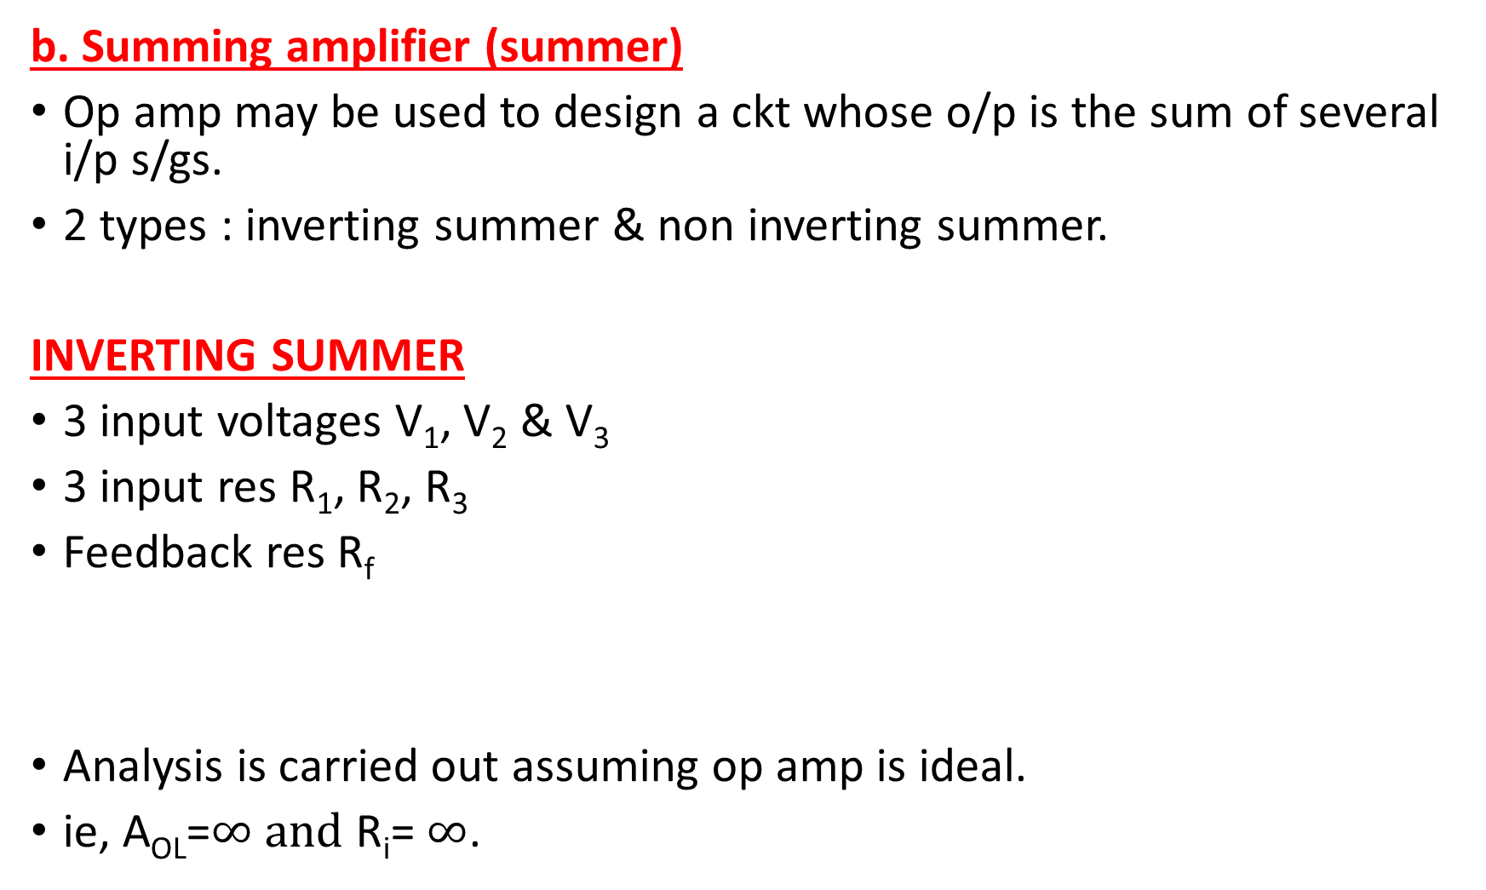
b. Summing amplifier (summer)
Op amp may be used to design a ckt whose o/p is the sum of several i/p s/gs.
2 types : inverting summer & non inverting summer.
INVERTING SUMMER
3 input voltages V₁, V₂ & V₃
3 input res R₁, R₂, R₃
Feedback res R_{f}
Analysis is carried out assuming op amp is ideal.
ie, A_{OL}=$∞ and$ R_{i}= $∞$.

Slide 6
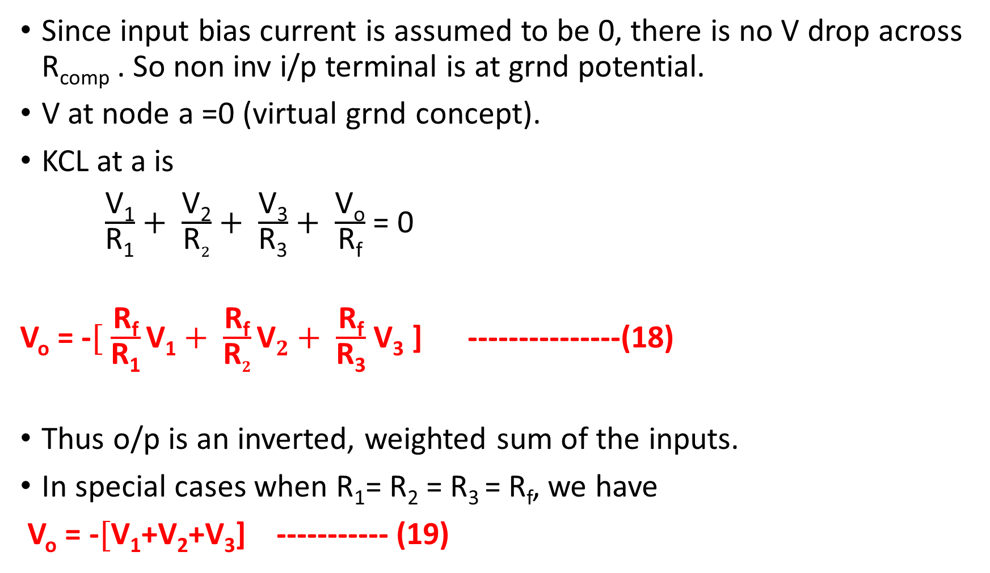
Since input bias current is assumed to be 0, there is no V drop across R_{comp} . So non inv i/p terminal is at grnd potential.
V at node a =0 (virtual grnd concept).
KCL at a is
$\frac{\text{V}\text{1}}{\text{R}\text{1}}+ \frac{\text{V}\text{2}}{\text{R}2}+ \frac{\text{V}\text{3}}{\text{R}\text{3}}+ \frac{\text{V}\text{o}}{\text{R}\text{f}}$ = 0
V_{o} = -$[ \frac{\text{R}\text{f}}{\text{R}\text{1}}\text{V}\text{1}+ \frac{\text{R}\text{f}}{\text{R}2}\text{V}2+ \frac{\text{R}\text{f}}{\text{R}\text{3}}$ $\text{V}\text{3}$ ] ---------------(18)
Thus o/p is an inverted, weighted sum of the inputs.
In special cases when R₁= R₂ = R₃ = R_{f}, we have
V_{o} = -$[$V₁+V₂+V₃] ----------- (19)

Slide 7
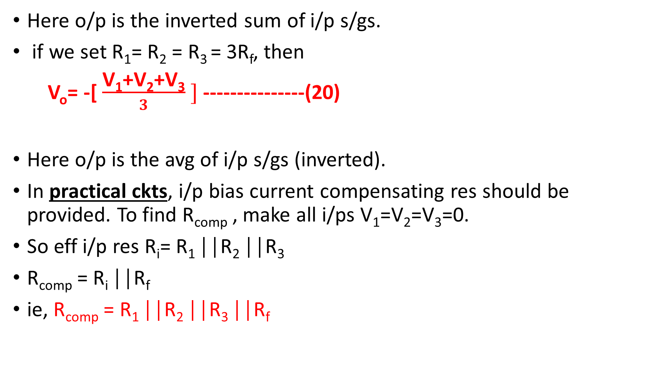
Here o/p is the inverted sum of i/p s/gs.
if we set R₁= R₂ = R₃ = 3R_{f}, then
V_{o}= -[ $\frac{\text{V}\text{1}\text{+}\text{V}\text{2}\text{+}\text{V}\text{3}}{3} ]$ ---------------(20)
Here o/p is the avg of i/p s/gs (inverted).
In practical ckts, i/p bias current compensating res should be provided. To find R_{comp} , make all i/ps V₁=V₂=V₃=0.
So eff i/p res R_{i}= R₁ ││R₂ ││R₃
R_{comp} = R_{i} ││R_{f}
ie, R_{comp} = R₁ ││R₂ ││R₃ ││R_{f}

Slide 8
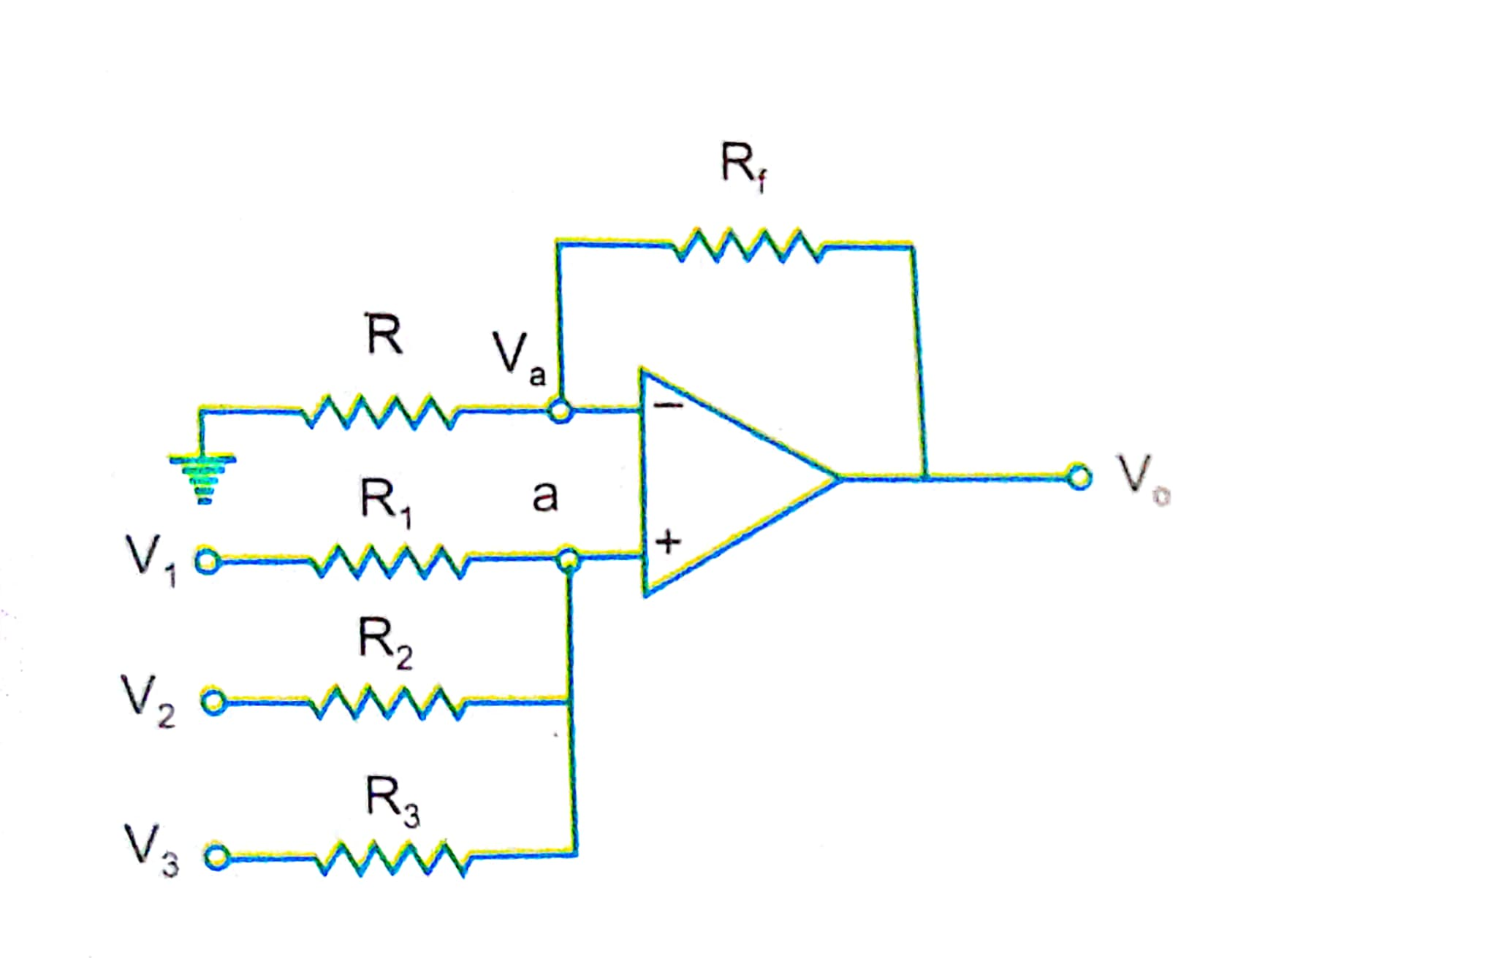
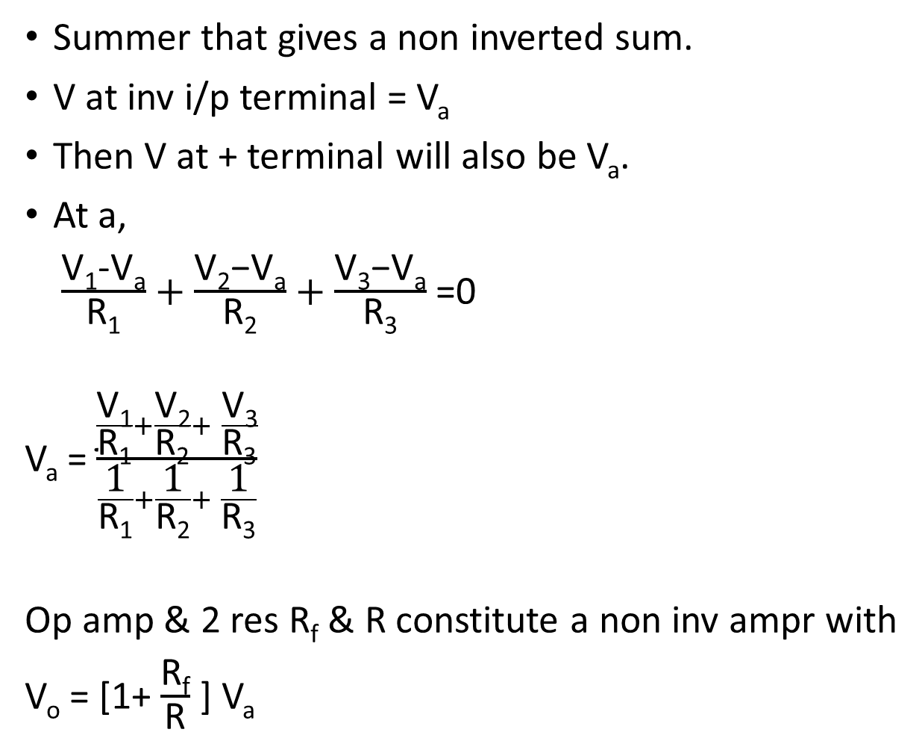
NON INVERTING SUMMER
Summer that gives a non inverted sum.
V at inv i/p terminal = V_{a}
Then V at + terminal will also be V_{a}.
At a,
$\frac{\text{V}\text{1}\text{−}\text{Va}}{\text{R}\text{1}}+\frac{\text{V}\text{2}\text{−}\text{Va}}{\text{R}\text{2}}+$ $\frac{\text{V}\text{3}\text{−}\text{Va}}{\text{R}\text{3}}$ =0
V_{a} = $\frac{\frac{\text{V}\text{1}}{\text{R}\text{1}}+\frac{\text{V}\text{2}}{\text{R}\text{2}}+ \frac{\text{V}\text{3}}{\text{R}\text{3}}}{\frac{\text{1}}{\text{R}\text{1}}+\frac{\text{1}}{\text{R}\text{2}}+ \frac{\text{1}}{\text{R}\text{3}}}$
Op amp & 2 res R_{f} & R constitute a non inv ampr with
V_{o} = [1+ $\frac{\text{R}\text{f}}{\text{R}}$ ] V_{a}

Slide 9
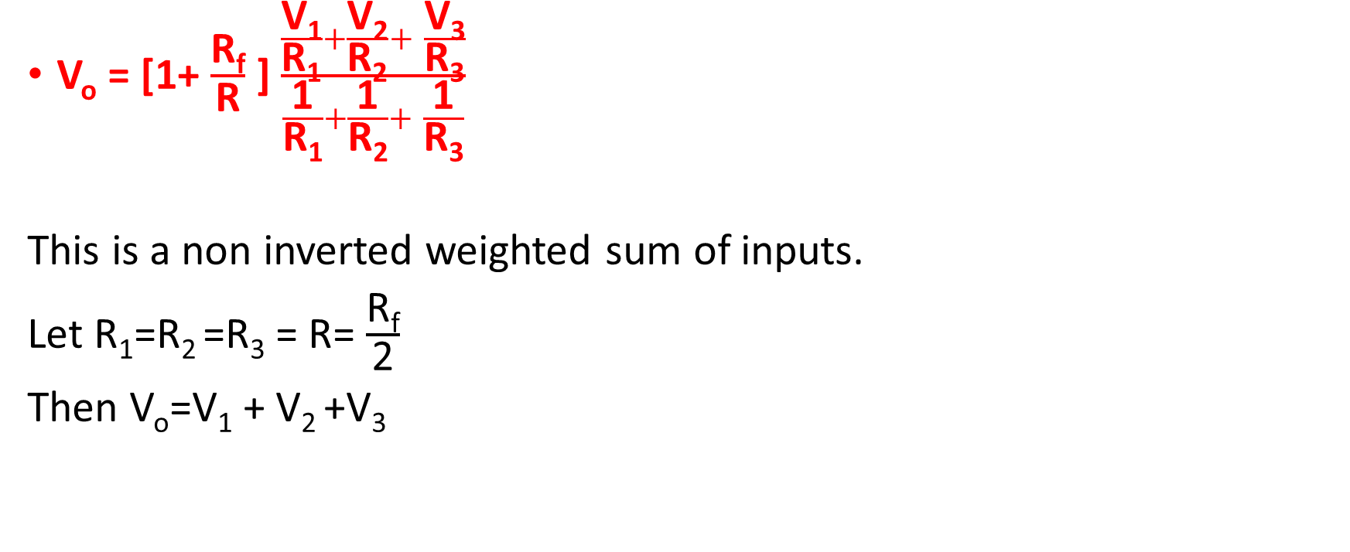
V_{o} = [1+ $\frac{\text{R}\text{f}}{\text{R}}$ ] $\frac{\frac{\text{V}\text{1}}{\text{R}\text{1}}+\frac{\text{V}\text{2}}{\text{R}\text{2}}+ \frac{\text{V}\text{3}}{\text{R}\text{3}}}{\frac{\text{1}}{\text{R}\text{1}}+\frac{\text{1}}{\text{R}\text{2}}+ \frac{\text{1}}{\text{R}\text{3}}}$
This is a non inverted weighted sum of inputs.
Let R₁=R₂ =R₃ = R= $\frac{\text{R}\text{f}}{\text{2}}$
Then V_{o}=V₁ + V₂ +V₃

Slide 10
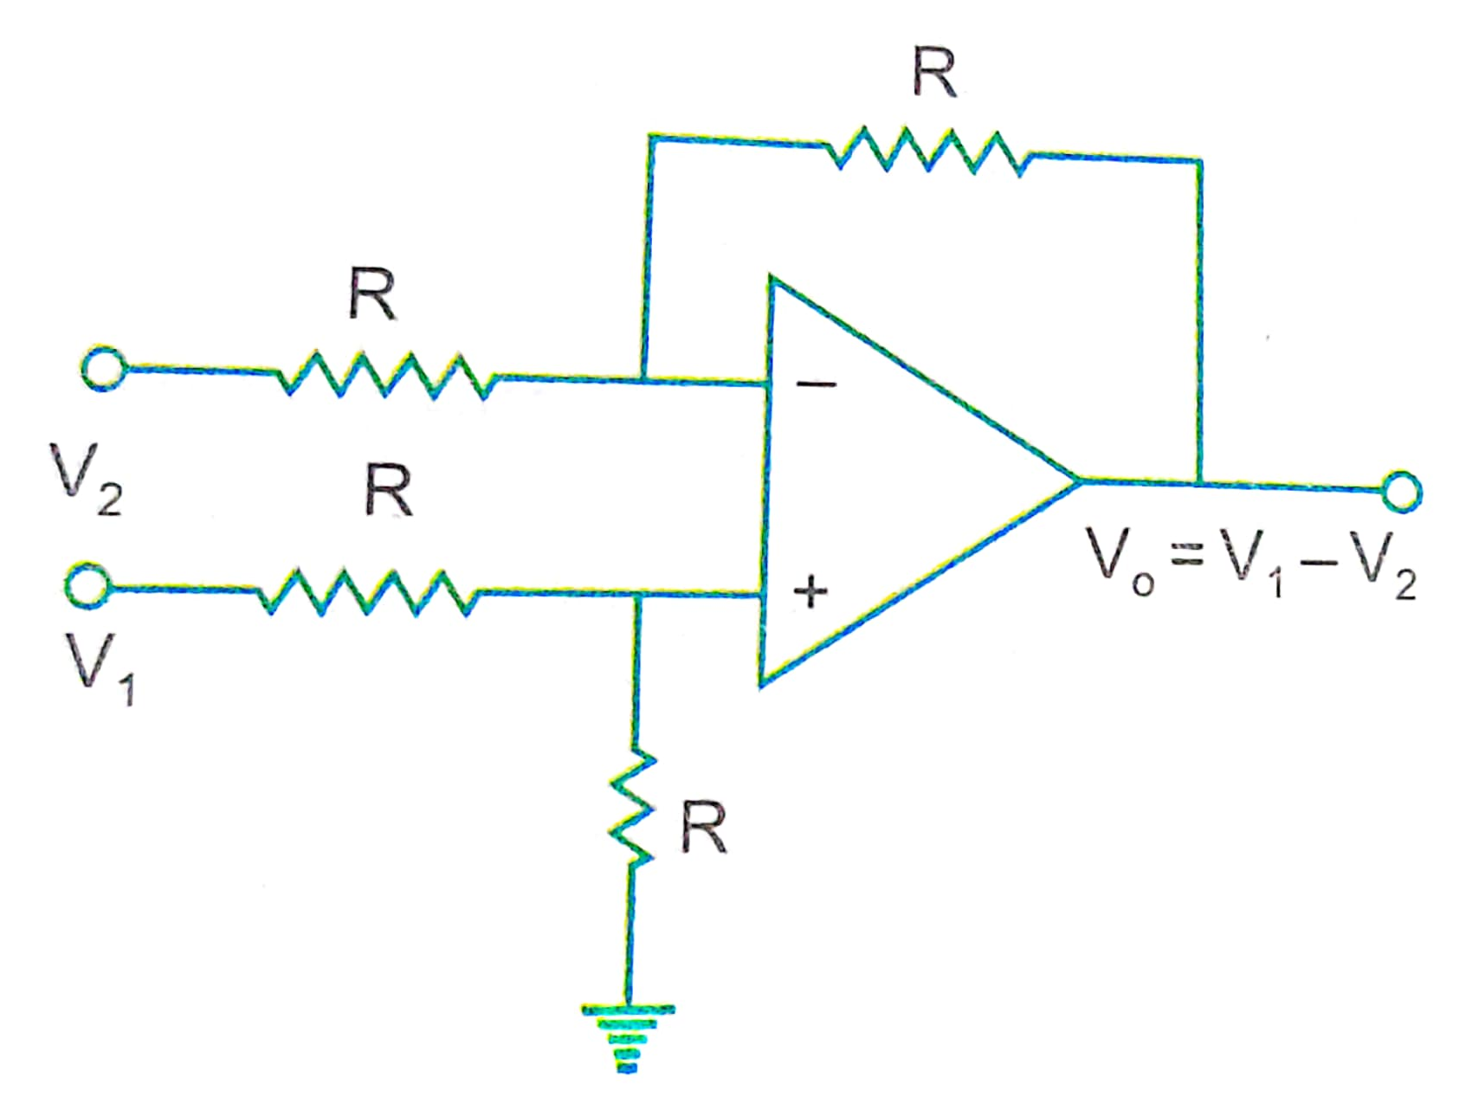
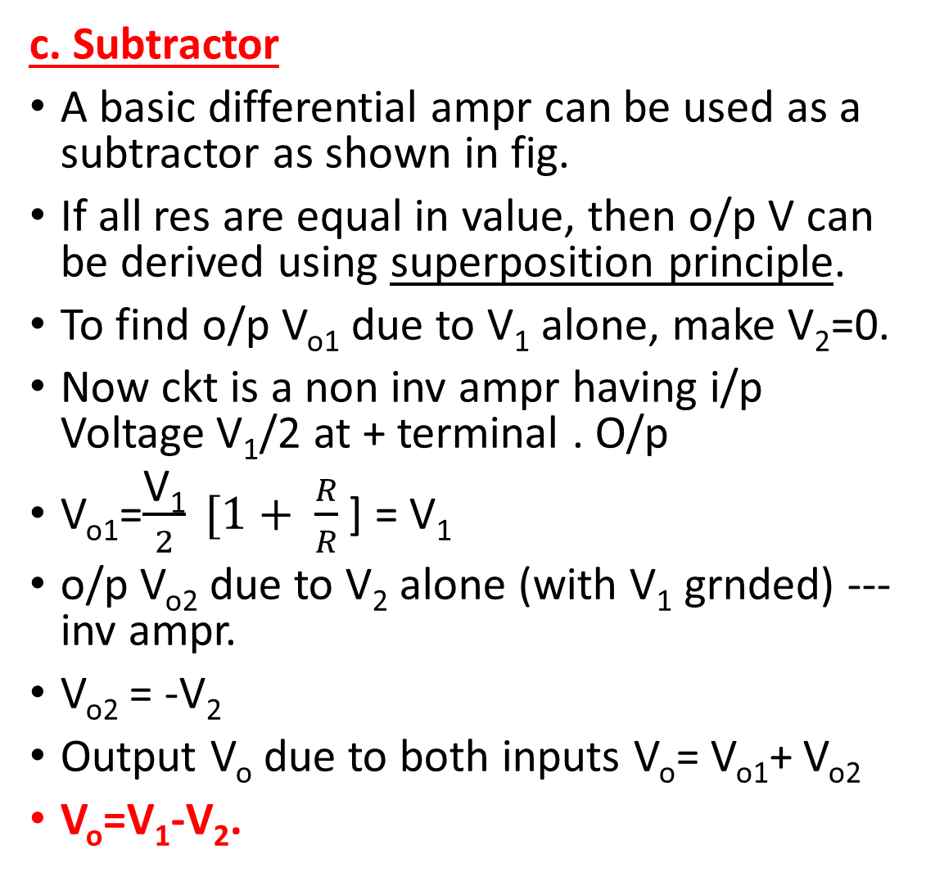
c. Subtractor
A basic differential ampr can be used as a subtractor as shown in fig.
If all res are equal in value, then o/p V can be derived using superposition principle.
To find o/p V_{o1} due to V₁ alone, make V₂=0.
Now ckt is a non inv ampr having i/p Voltage V₁/2 at + terminal . O/p
V_{o1}=$\frac{\text{V}\text{1}}{2} [1+ \frac{R}{R}$ ] = V₁
o/p V_{o2} due to V₂ alone (with V₁ grnded) ---inv ampr.
V_{o2} = -V₂
Output V_{o} due to both inputs V_{o}= V_{o1}+ V_{o2}
V_{o}=V₁-V₂.

Slide 11
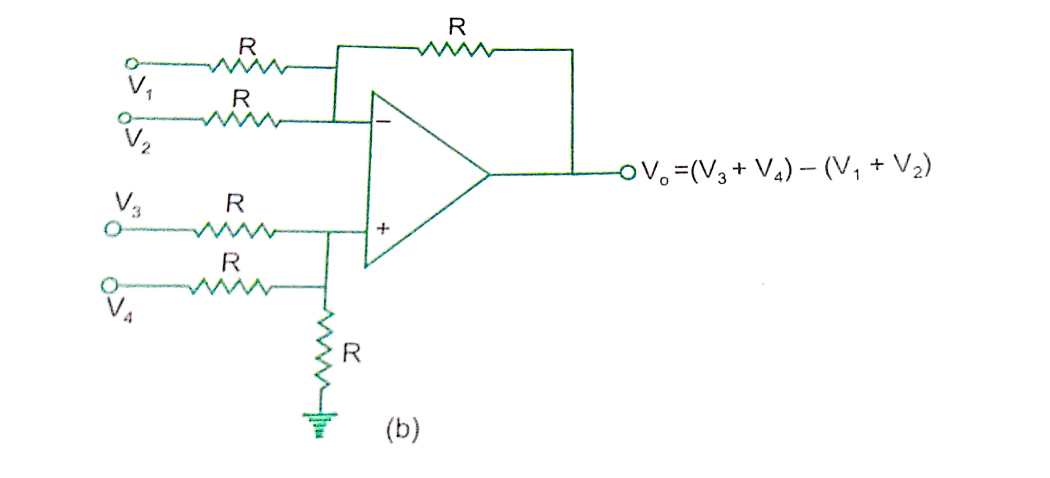
d. Adder-Subtractor
We can perform addition & subtraction simultaneously with a single op amp using this ckt.
V_{o} by superposition thrm.
To find V_{o1} due to V₁ alone, make all other i/p voltages V₂, V₃ and V₄ =0.
Ckt now becomes inv ampr.

Slide 12
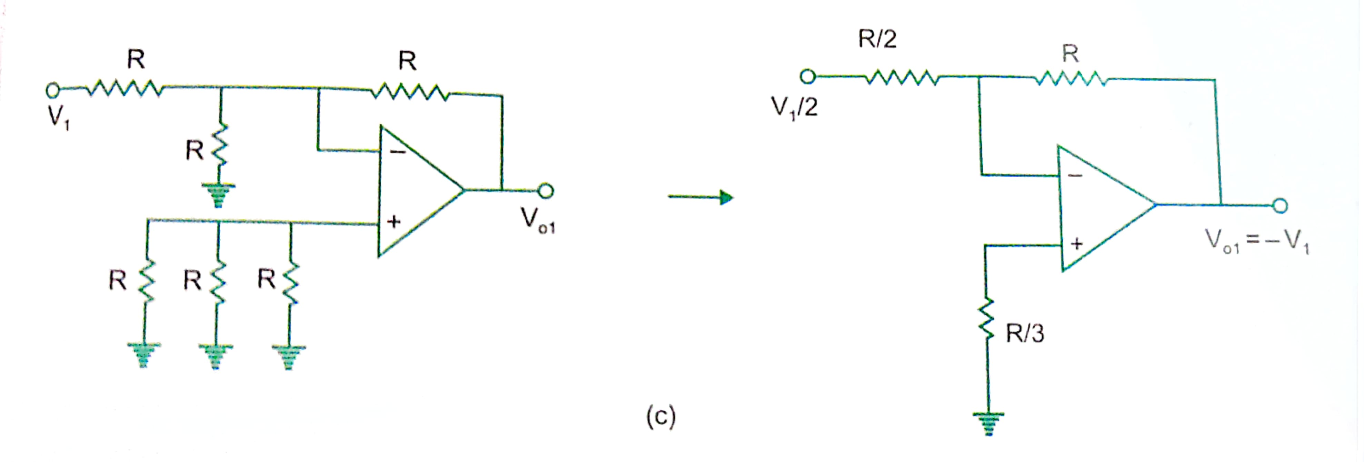
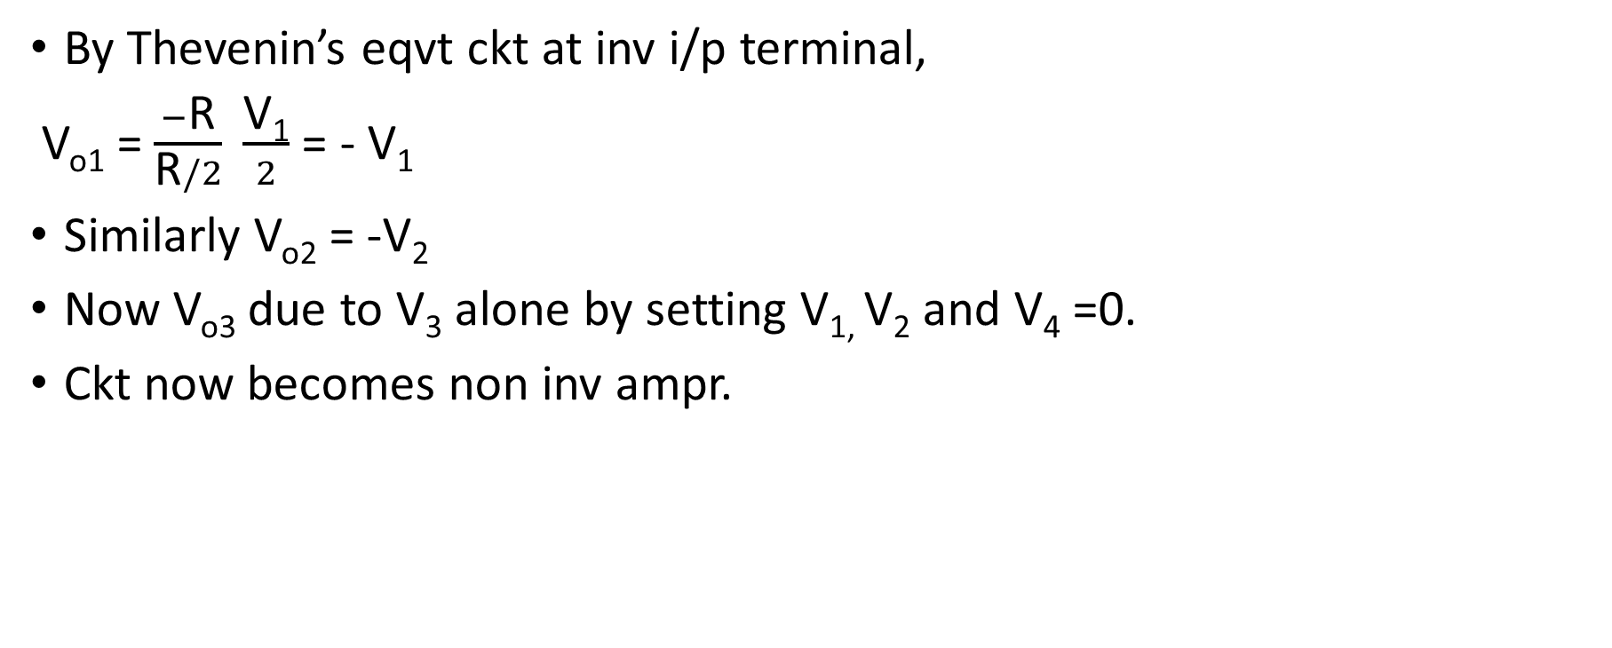
By Thevenin’s eqvt ckt at inv i/p terminal,
V_{o1} = $\frac{−\text{R}}{\text{R}/2} \frac{\text{V}\text{1}}{2}$ = - V₁
Similarly V_{o2} = -V₂
Now V_{o3} due to V₃ alone by setting V_{1,} V₂ and V₄ =0.
Ckt now becomes non inv ampr.

Slide 13
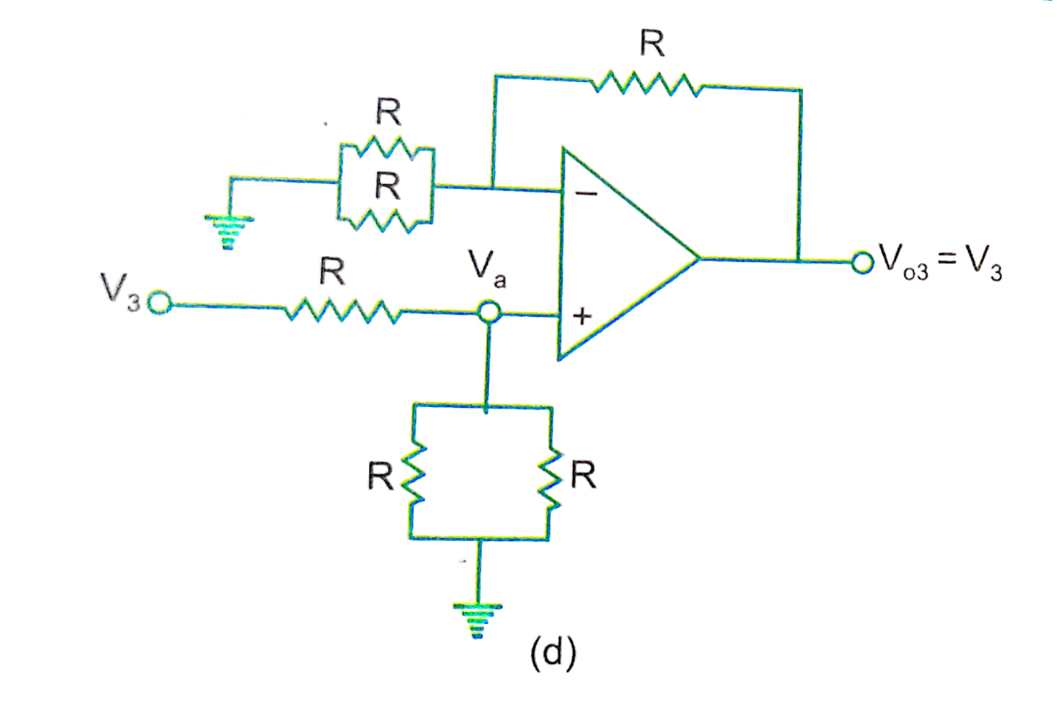
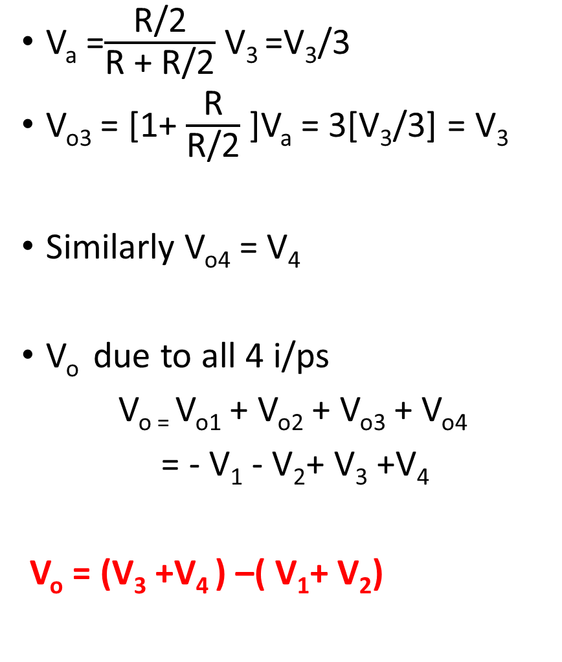
V_{a} =$\frac{\text{R}\text{/2}}{\text{R}\text{ + }\text{R}\text{/2}}$ V₃ =V₃/3
V_{o3} = [1+ $\frac{\text{R}}{\text{R}\text{/2}}$ ]V_{a} = 3[V₃/3] = V₃
Similarly V_{o4} = V₄
V_{o} due to all 4 i/ps
V_{o =} V_{o1} + V_{o2} + V_{o3} + V_{o4}
= - V₁ - V₂+ V₃ +V₄
V_{o} = (V₃ +V₄ ) –( V₁+ V₂)

Slide 14
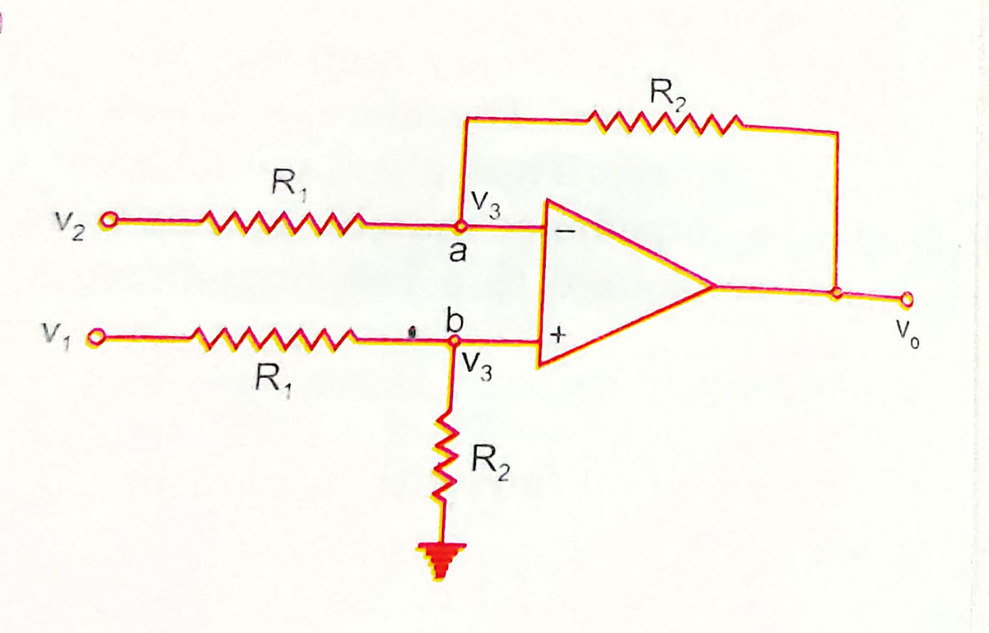
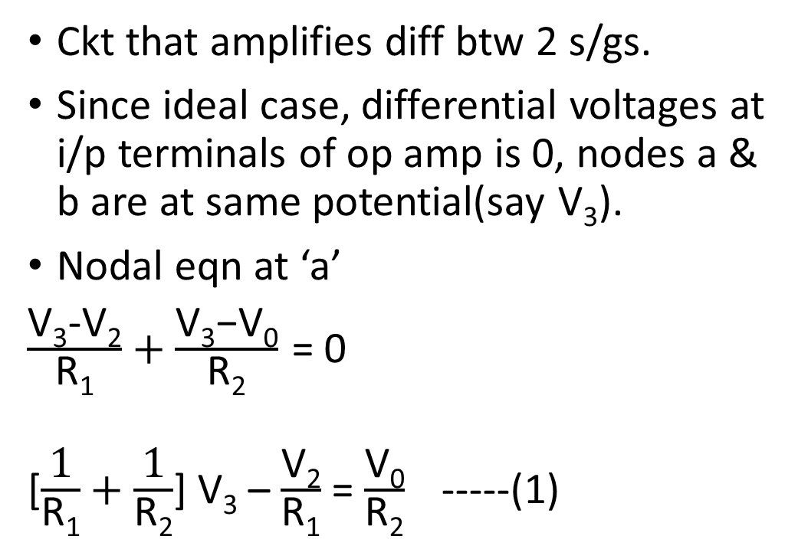
2.Differential Amplifier
Ckt that amplifies diff btw 2 s/gs.
Since ideal case, differential voltages at i/p terminals of op amp is 0, nodes a & b are at same potential(say V₃).
Nodal eqn at ‘a’
$\frac{\text{V}\text{3}\text{−}\text{V}\text{2}}{\text{R}\text{1}}+\frac{\text{V}\text{3}\text{−}\text{V}\text{0}}{\text{R}\text{2}}$= 0
[$\frac{\text{1}}{\text{R}\text{1}}+\frac{\text{1}}{\text{R}\text{2}}$] V₃ – $\frac{\text{V}\text{2}}{\text{R}\text{1}}$ = $\frac{\text{V}\text{0}}{\text{R}\text{2}}$ -----(1)

Slide 15
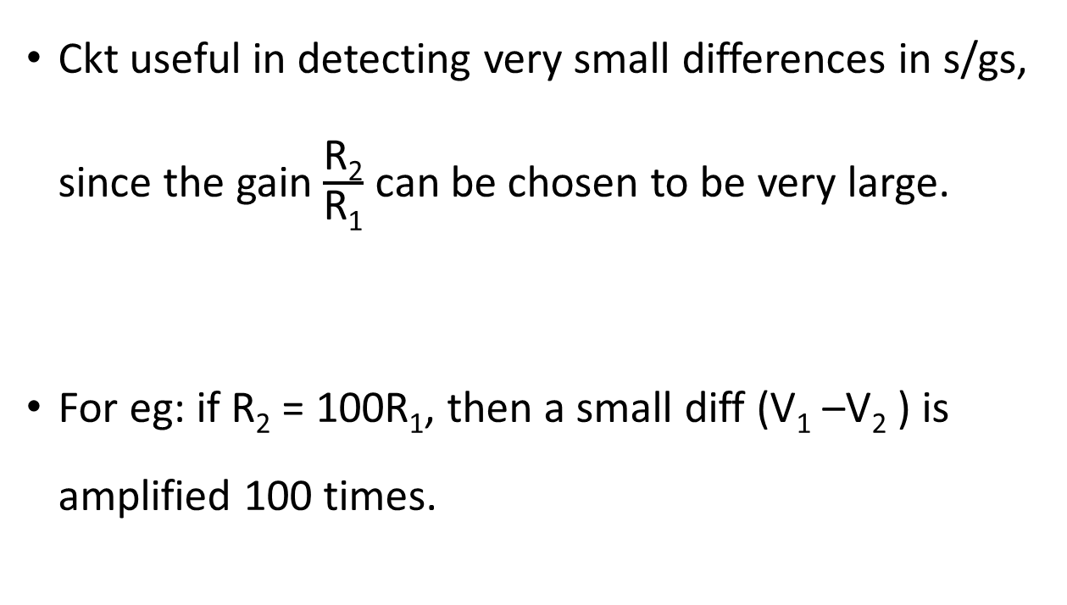
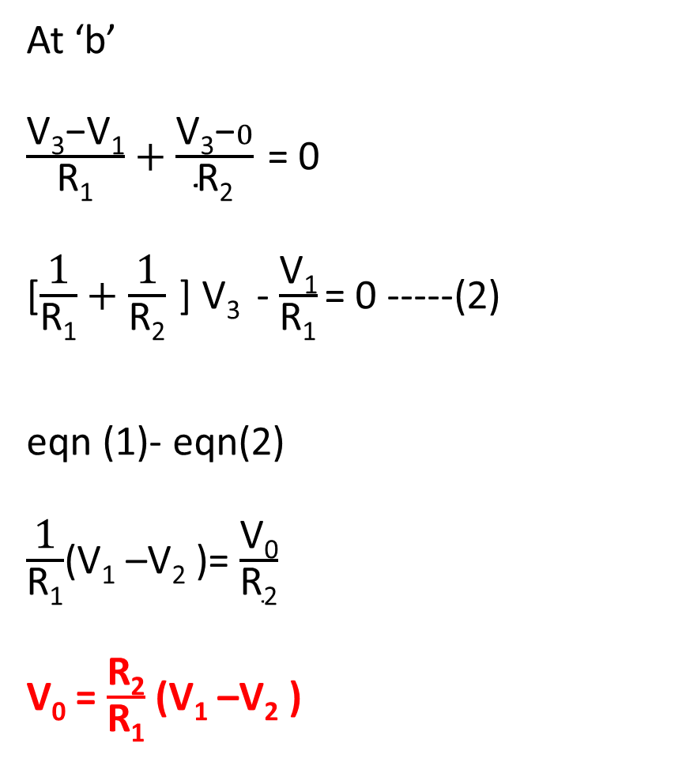
At ‘b’
$\frac{\text{V}\text{3}\text{−}\text{V}\text{1}}{\text{R}\text{1}}+\frac{\text{V}\text{3}\text{−}0}{\text{R}\text{2}}$= 0
[$\frac{\text{1}}{\text{R}\text{1}}+\frac{\text{1}}{\text{R}\text{2}}$] V₃ - $\frac{\text{V}\text{1}}{\text{R}\text{1}}$= 0 -----(2)
eqn (1)- eqn(2)
$\frac{\text{1}}{\text{R}\text{1}}$(V₁ –V₂ )= $\frac{\text{V}\text{0}}{\text{R}\text{2}}$
$\text{V}\text{0}$ = $\frac{\text{R}\text{2}}{\text{R}\text{1}}$ (V₁ –V₂ )
Ckt useful in detecting very small differences in s/gs, since the gain $\frac{\text{R}\text{2}}{\text{R}\text{1}}$ can be chosen to be very large.
For eg: if R₂ = 100R₁, then a small diff (V₁ –V₂ ) is amplified 100 times.

Slide 16
3.Instrumentation amplifier
We need to measure & control physical quantities(industrial & consumer applications).
Eg: measurement & control of temp, humidity, light intensity, water flow, etc.
These physical quantities are usually measured with the help of transducers.
o/p of transducer has to be amplified so that it can drive the indicator or display s/m.
This function is performed by an instrumentation ampr.

Slide 17
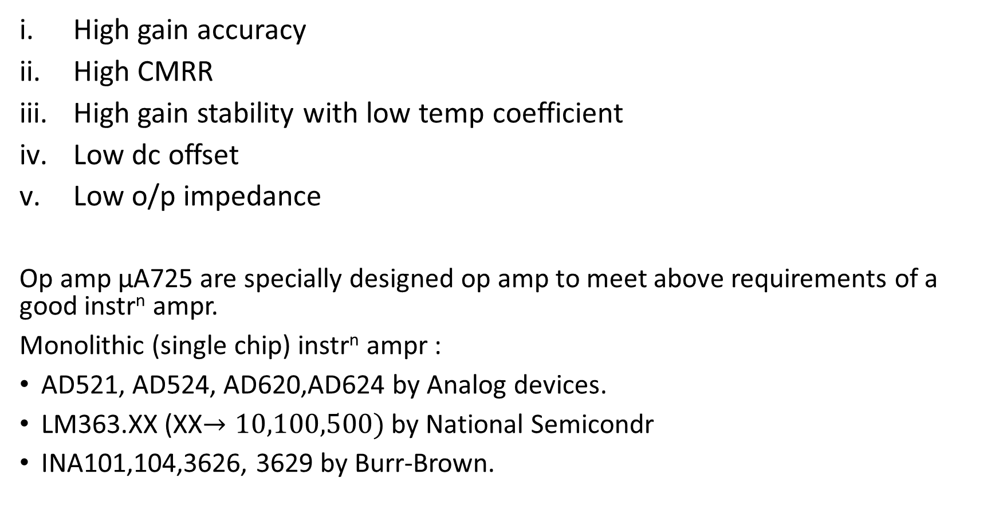
Imp features of instrumentation ampr
High gain accuracy
High CMRR
High gain stability with low temp coefficient
Low dc offset
Low o/p impedance
Op amp µA725 are specially designed op amp to meet above requirements of a good instr^{n} ampr.
Monolithic (single chip) instr^{n} ampr :
AD521, AD524, AD620,AD624 by Analog devices.
LM363.XX (XX$→10,100,500)$by National Semicondr
INA101,104,3626, 3629 by Burr-Brown.

Slide 18
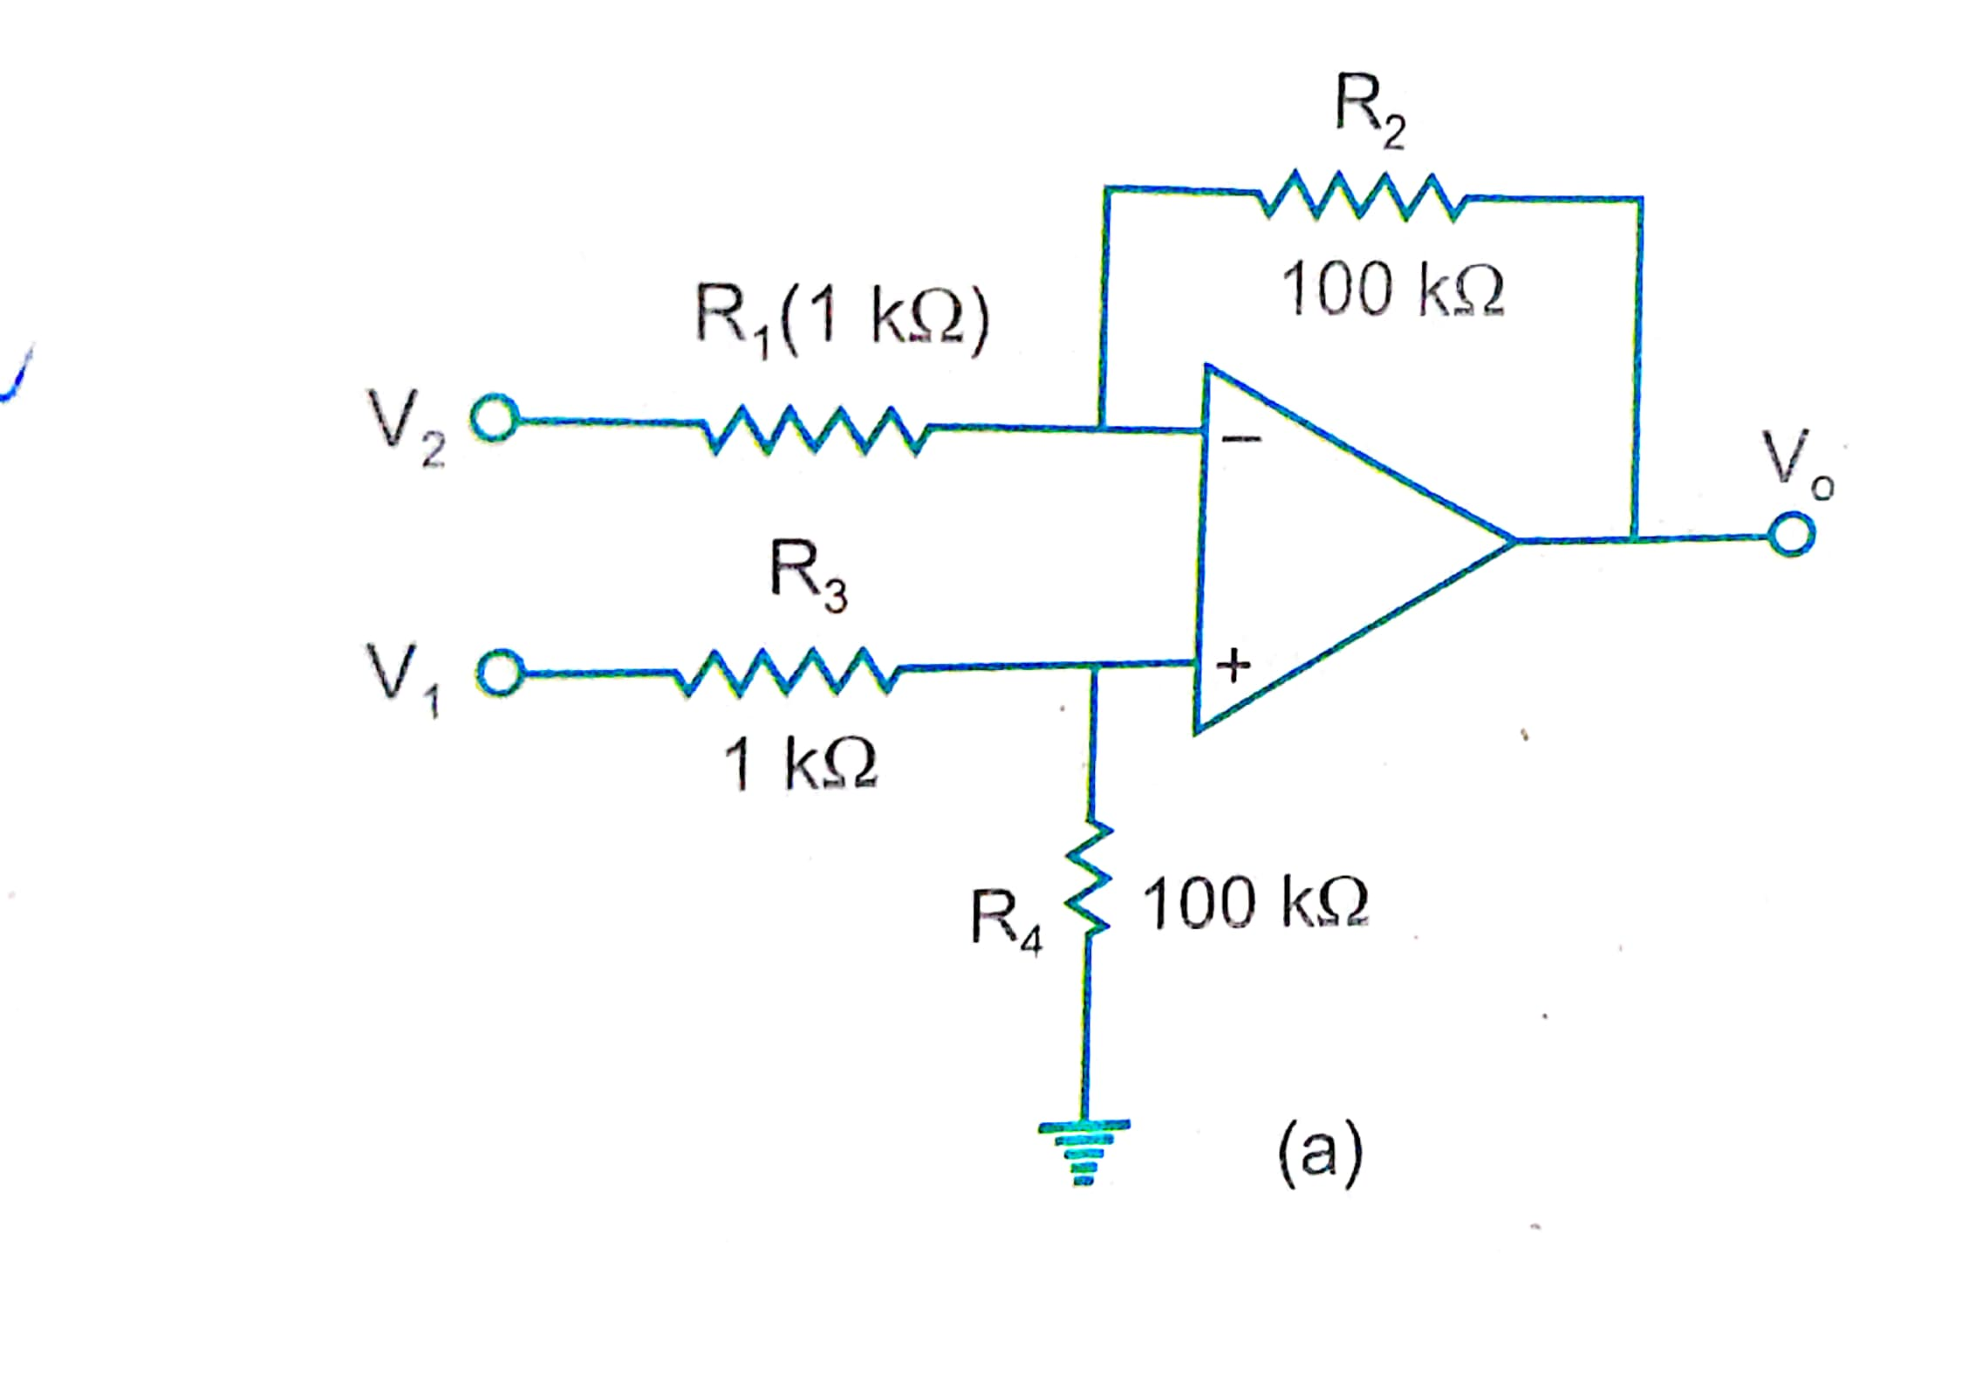
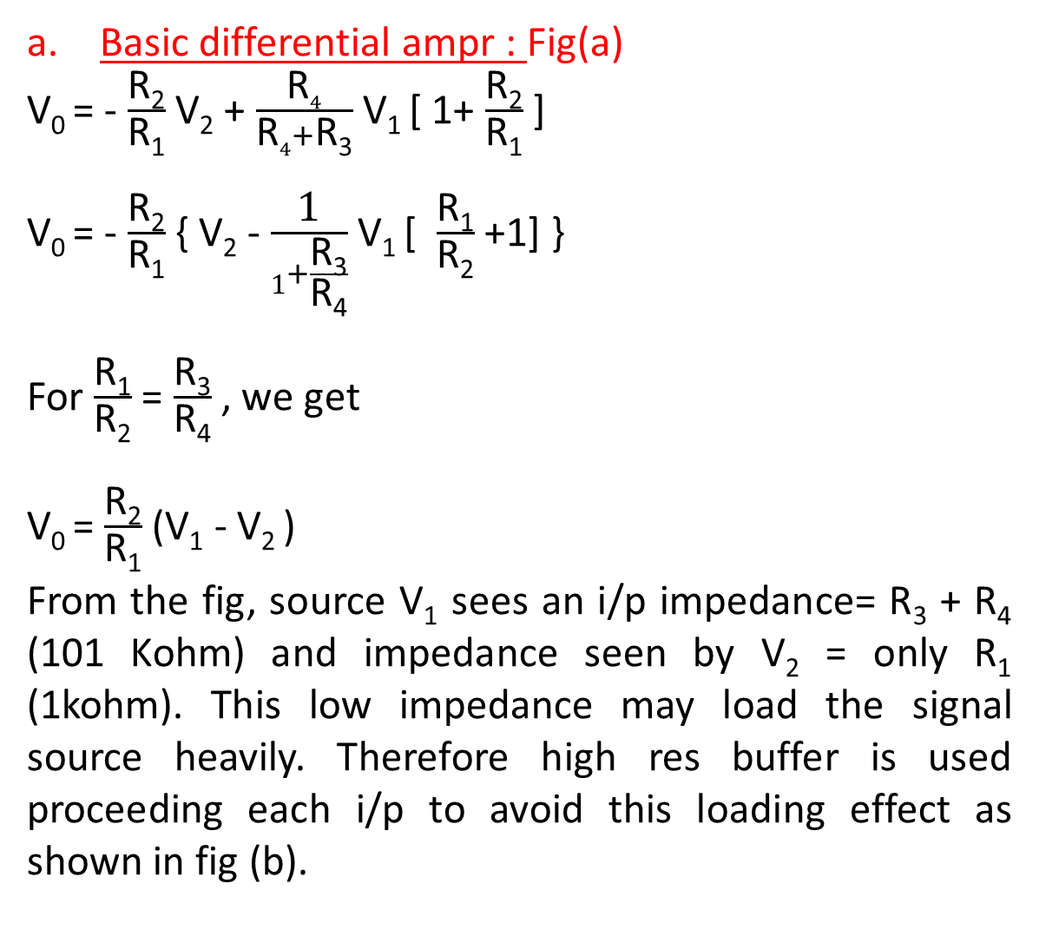
Basic differential ampr : Fig(a)
V₀ = - $\frac{\text{R}\text{2}}{\text{R}\text{1}}$ V₂ + $\frac{\text{R}4}{\text{R}4+\text{R}\text{3}}$ V₁ [ 1+ $\frac{\text{R}\text{2}}{\text{R}\text{1}}$ ]
V₀ = - $\frac{\text{R}\text{2}}{\text{R}\text{1}}$ { V₂ - $\frac{\text{1}}{\text{1}+\frac{\text{R}\text{3}}{\text{R}\text{4}}}$ V₁ [ $\frac{\text{R}\text{1}}{\text{R}\text{2}}$ +1] }
For $\frac{\text{R}\text{1}}{\text{R}\text{2}}$ = $\frac{\text{R}\text{3}}{\text{R}\text{4}}$ , we get
V₀ = $\frac{\text{R}\text{2}}{\text{R}\text{1}}$ (V₁ - V₂ )
From the fig, source V₁ sees an i/p impedance= R₃ + R₄ (101 Kohm) and impedance seen by V₂ = only R₁ (1kohm). This low impedance may load the signal source heavily. Therefore high res buffer is used proceeding each i/p to avoid this loading effect as shown in fig (b).

Slide 19
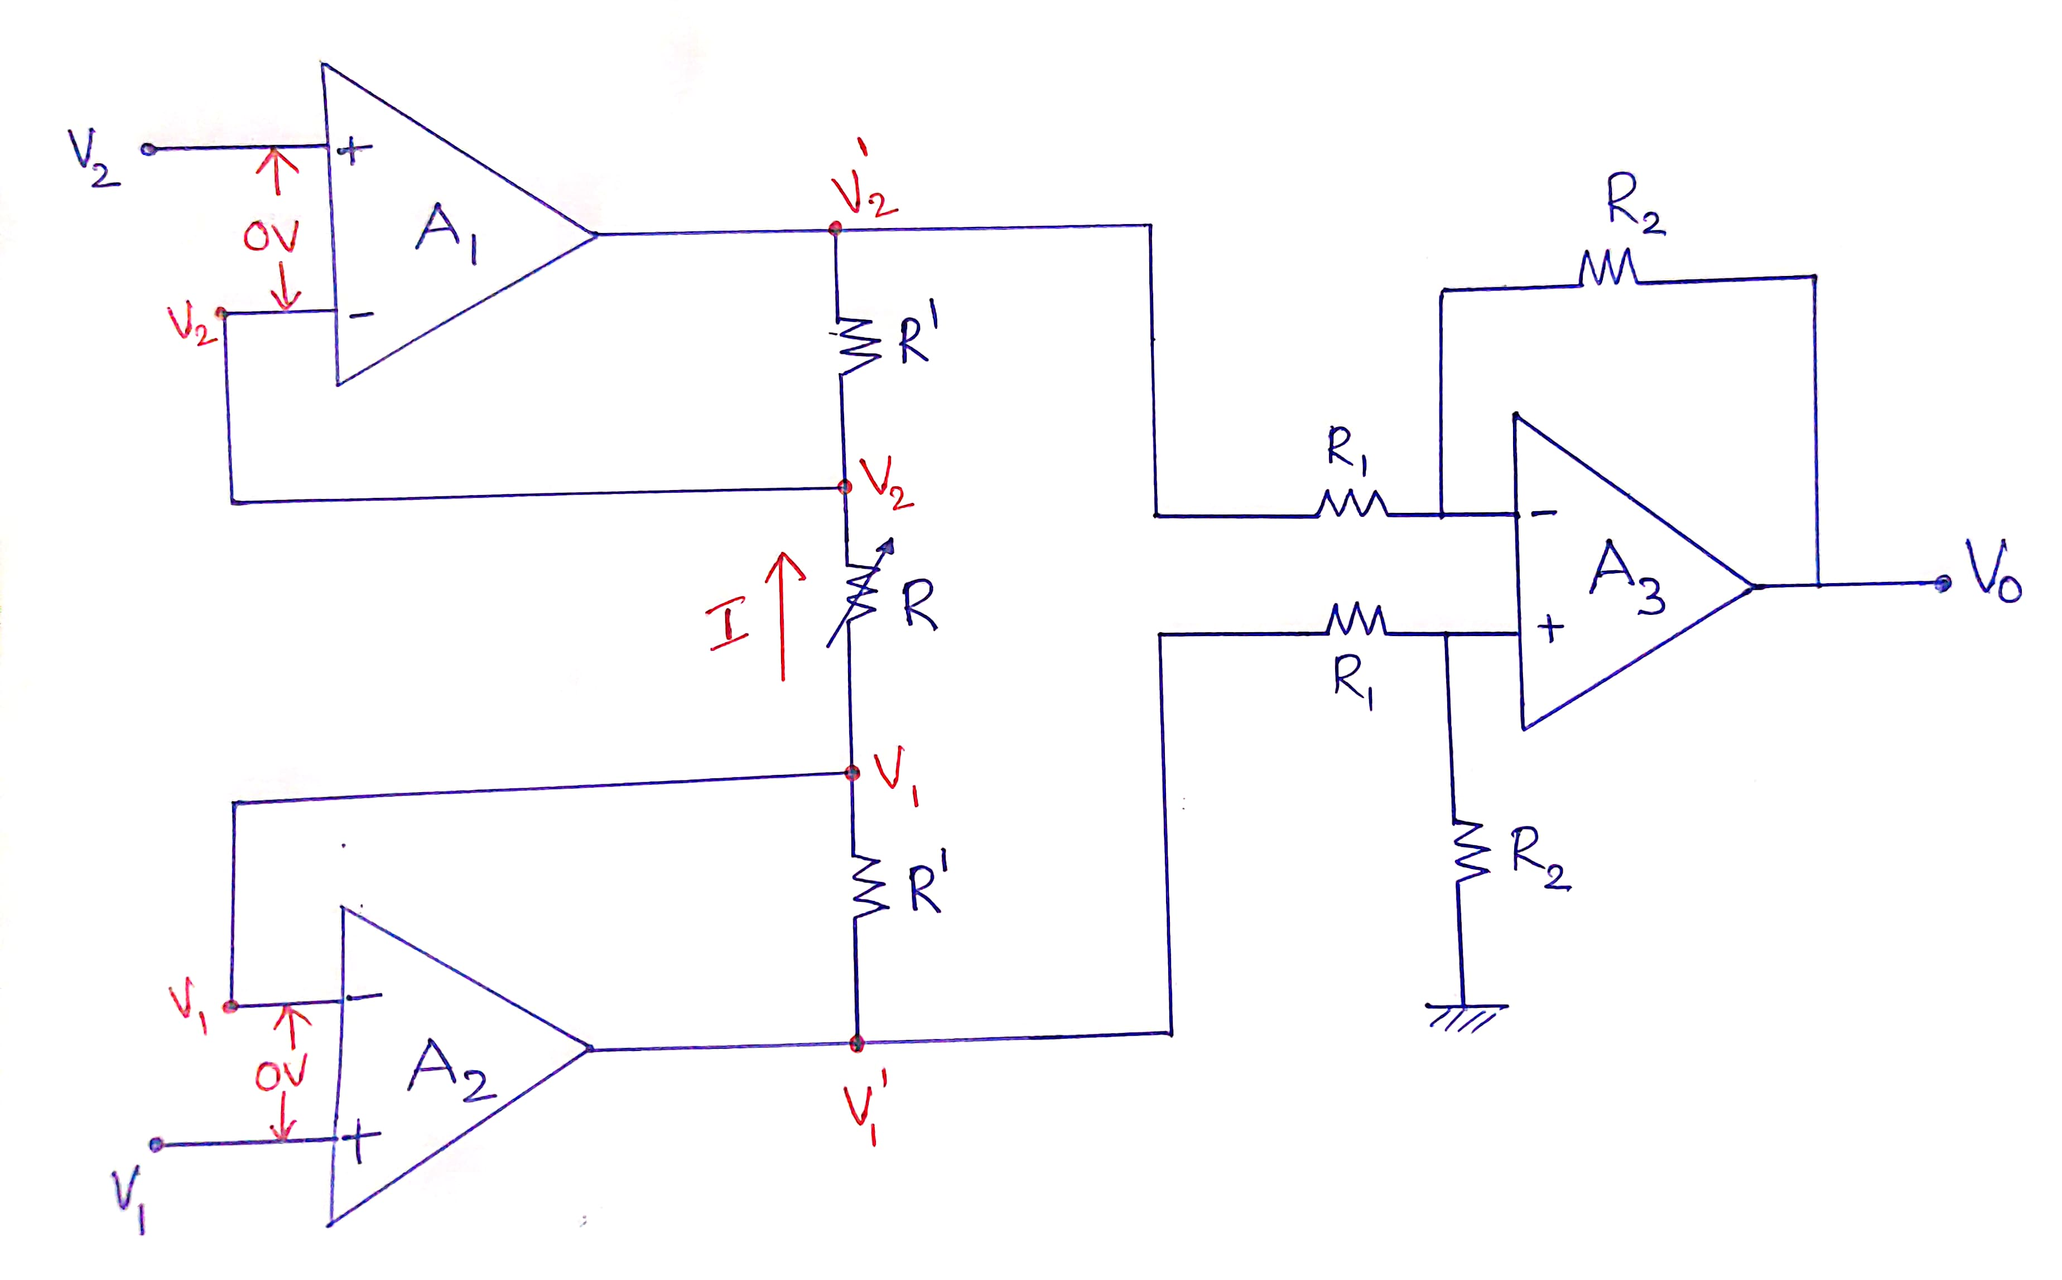
(b) An improved instrumentation ampr :Fig(b)

Slide 20
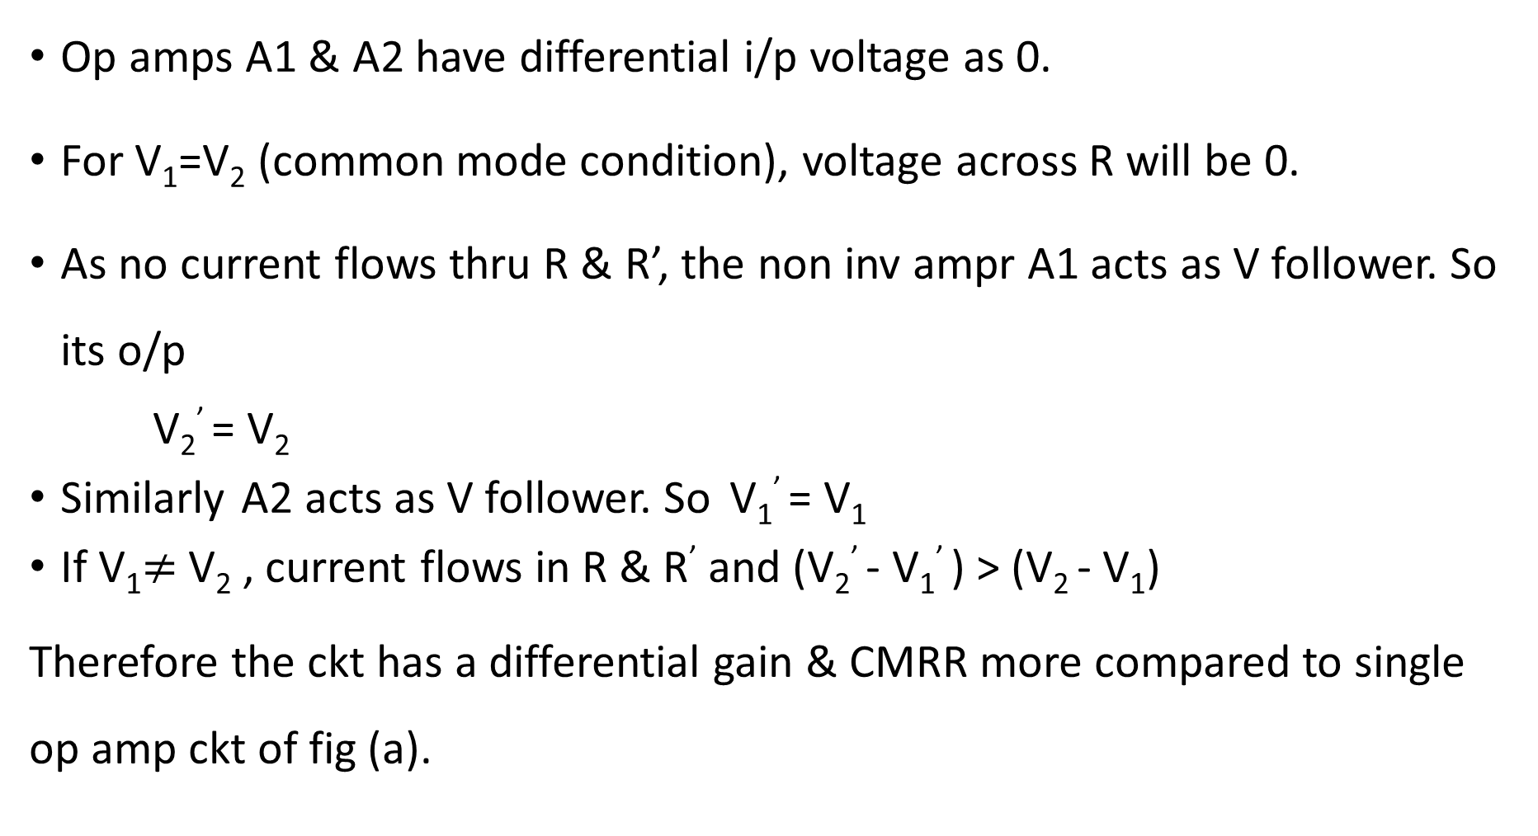
Op amps A1 & A2 have differential i/p voltage as 0.
For V₁=V₂ (common mode condition), voltage across R will be 0.
As no current flows thru R & R’, the non inv ampr A1 acts as V follower. So its o/p
V₂’ = V₂
Similarly A2 acts as V follower. So V₁’ = V₁
If V₁$≠$V₂ , current flows in R & R’ and (V₂’ - V₁’ ) > (V₂ - V₁)
Therefore the ckt has a differential gain & CMRR more compared to single op amp ckt of fig (a).

Slide 21
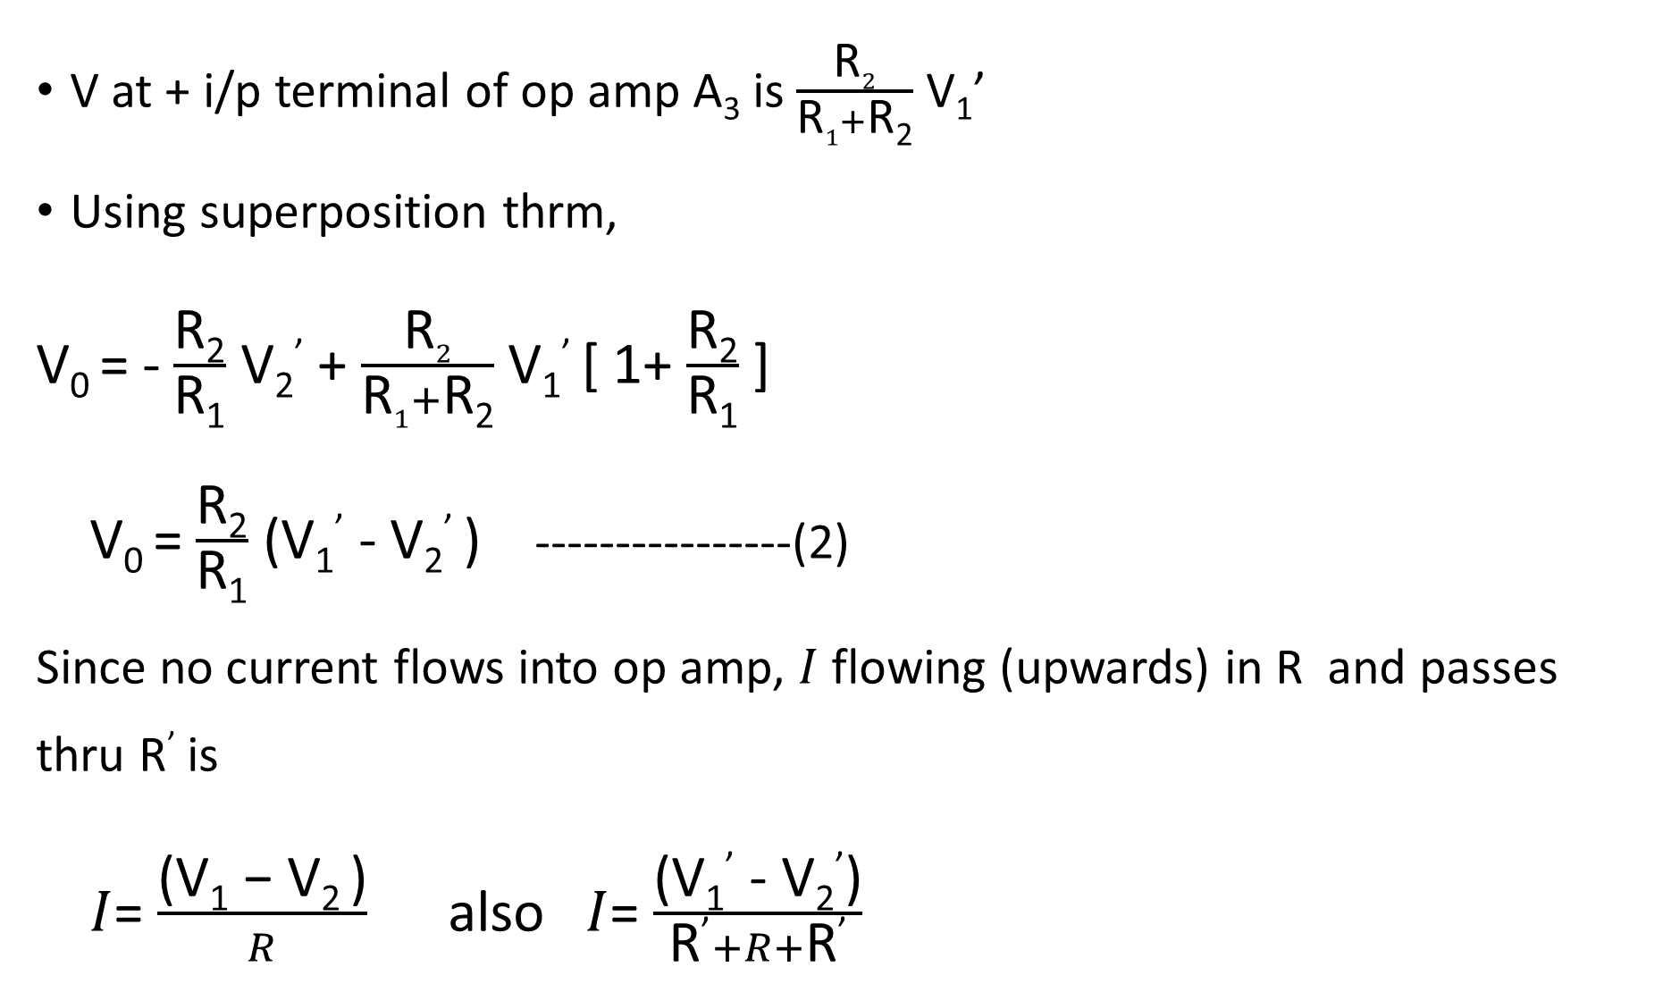
V at + i/p terminal of op amp A₃ is $\frac{\text{R}2}{\text{R}1+\text{R}\text{2}}$ V₁’
Using superposition thrm,
V₀ = - $\frac{\text{R}\text{2}}{\text{R}\text{1}}$ V₂’ + $\frac{\text{R}2}{\text{R}1+\text{R}\text{2}}$ V₁’ [ 1+ $\frac{\text{R}\text{2}}{\text{R}\text{1}}$ ]
V₀ = $\frac{\text{R}\text{2}}{\text{R}\text{1}}$ (V₁’ - V₂’ ) ----------------(2)
Since no current flows into op amp, $I$ flowing (upwards) in R and passes thru R’ is
$I$= $\frac{\text{(}\text{V}\text{1}\text{ − }\text{V}\text{2 }\text{)}}{R}$ also $I$= $\frac{\text{(}\text{V}\text{1}\text{’}\text{ − }\text{V}\text{2}\text{’}\text{)}}{\text{R}\text{’}+R+\text{R}\text{’}}$

Slide 22
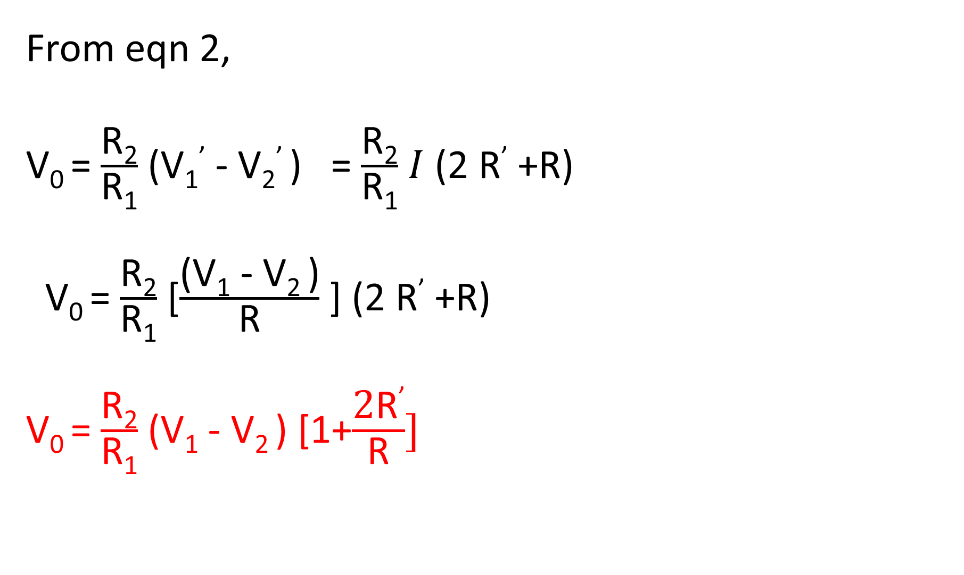
From eqn 2,
V₀ = $\frac{\text{R}\text{2}}{\text{R}\text{1}}$ (V₁’ - V₂’ ) = $\frac{\text{R}\text{2}}{\text{R}\text{1}}$ $I$ (2 R’ +R)
V₀ = $\frac{\text{R}\text{2}}{\text{R}\text{1}}$ [$\frac{\text{(}\text{V}\text{1}\text{ − }\text{V}\text{2 }\text{)}}{\text{R}}$ ] (2 R’ +R)
V₀ = $\frac{\text{R}\text{2}}{\text{R}\text{1}}$ (V₁ - V₂ ) [1+$\frac{\text{2}\text{R}\text{’}}{\text{R}}]$

Slide 23
In this eqn, if we choose R₂ = R₁ = 25Kohm (say) & R’=25Kohm, R=50 ohm, then gain = 1001.
The difference gain of this instrumentation ampr can be varied by replacing res R by a potentiometer in Fig(b).
R should never be made 0 as this will make the gain infinity.
To avoid this, a fixed res in series with a potentiometer is used in place of R.

Slide 24
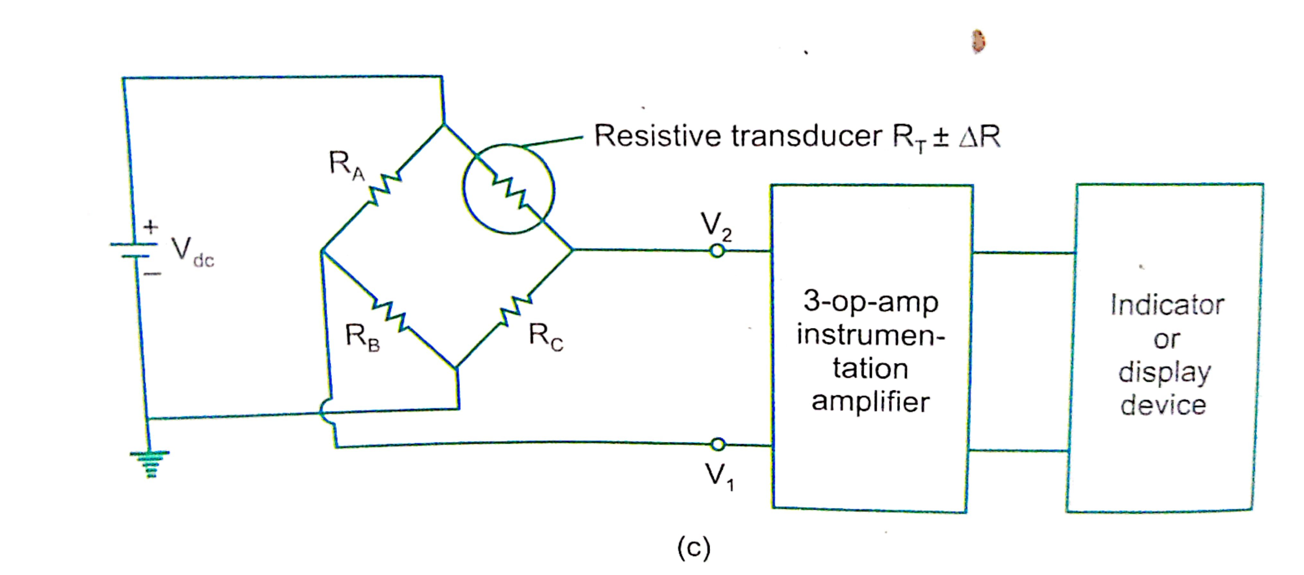
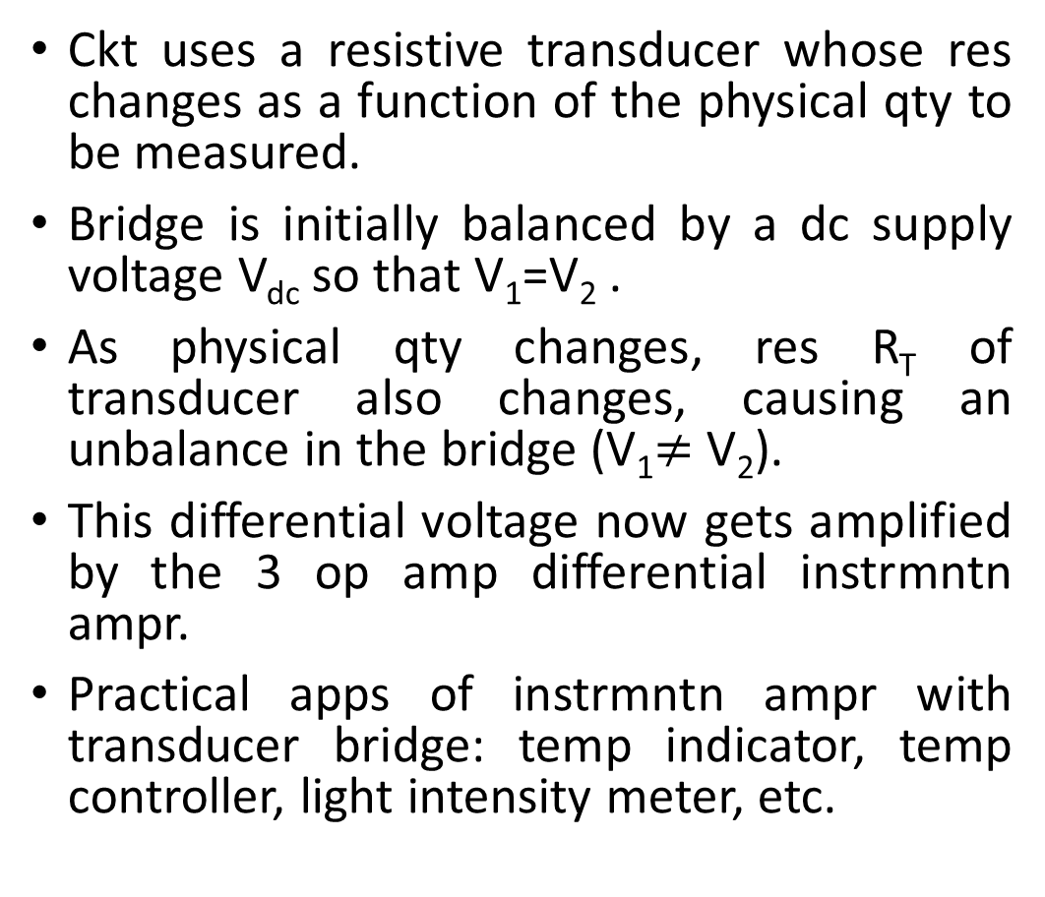
(c) Instrumentation ampr using transducer bridge : Fig©
Ckt uses a resistive transducer whose res changes as a function of the physical qty to be measured.
Bridge is initially balanced by a dc supply voltage V_{dc} so that V₁=V₂ .
As physical qty changes, res R_{T} of transducer also changes, causing an unbalance in the bridge (V₁$≠$ V₂).
This differential voltage now gets amplified by the 3 op amp differential instrmntn ampr.
Practical apps of instrmntn ampr with transducer bridge: temp indicator, temp controller, light intensity meter, etc.

Slide 25
4. V to I and I to V converter
4.1. Voltage to current converter (Transconductance ampr)
In many applications, one may have to convert a voltage s/g to a proportional o/p current.
2 types of ckt possible :
V-I converter with floating load
V-I converter with grounded load

Slide 26
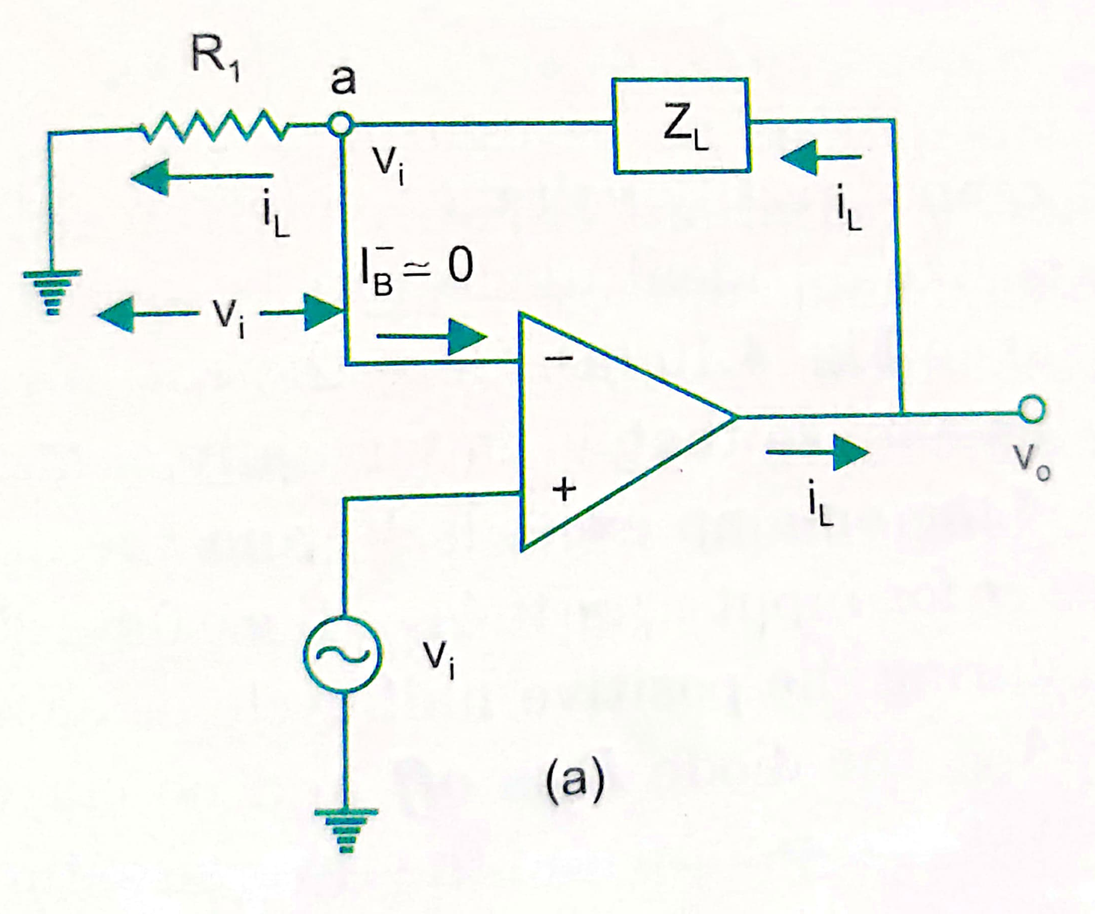
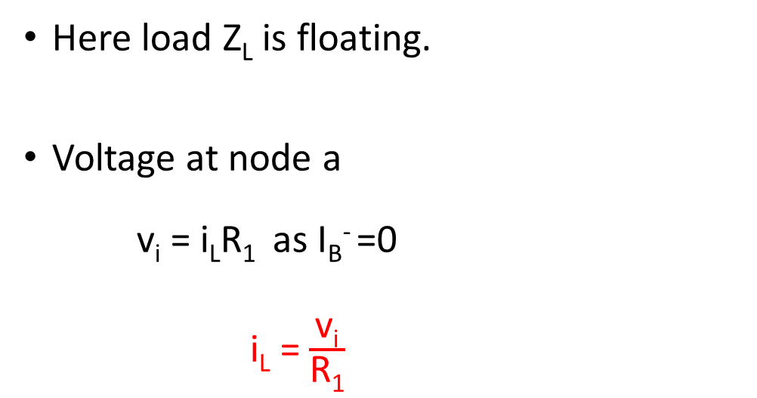
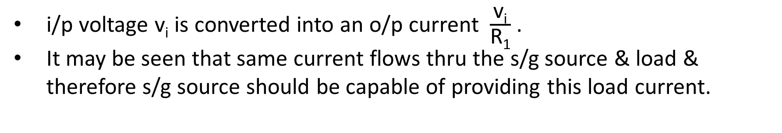
V-I converter with floating load
Here load Z_{L} is floating.
Voltage at node a
v_{i} = i_{L}R₁ as I_{B}⁻ =0
i_{L} = $\frac{\text{v}\text{i}}{\text{R}\text{1}}$
i/p voltage v_{i} is converted into an o/p current $\frac{\text{v}\text{i}}{\text{R}\text{1}}$ .
It may be seen that same current flows thru the s/g source & load & therefore s/g source should be capable of providing this load current.

Slide 27
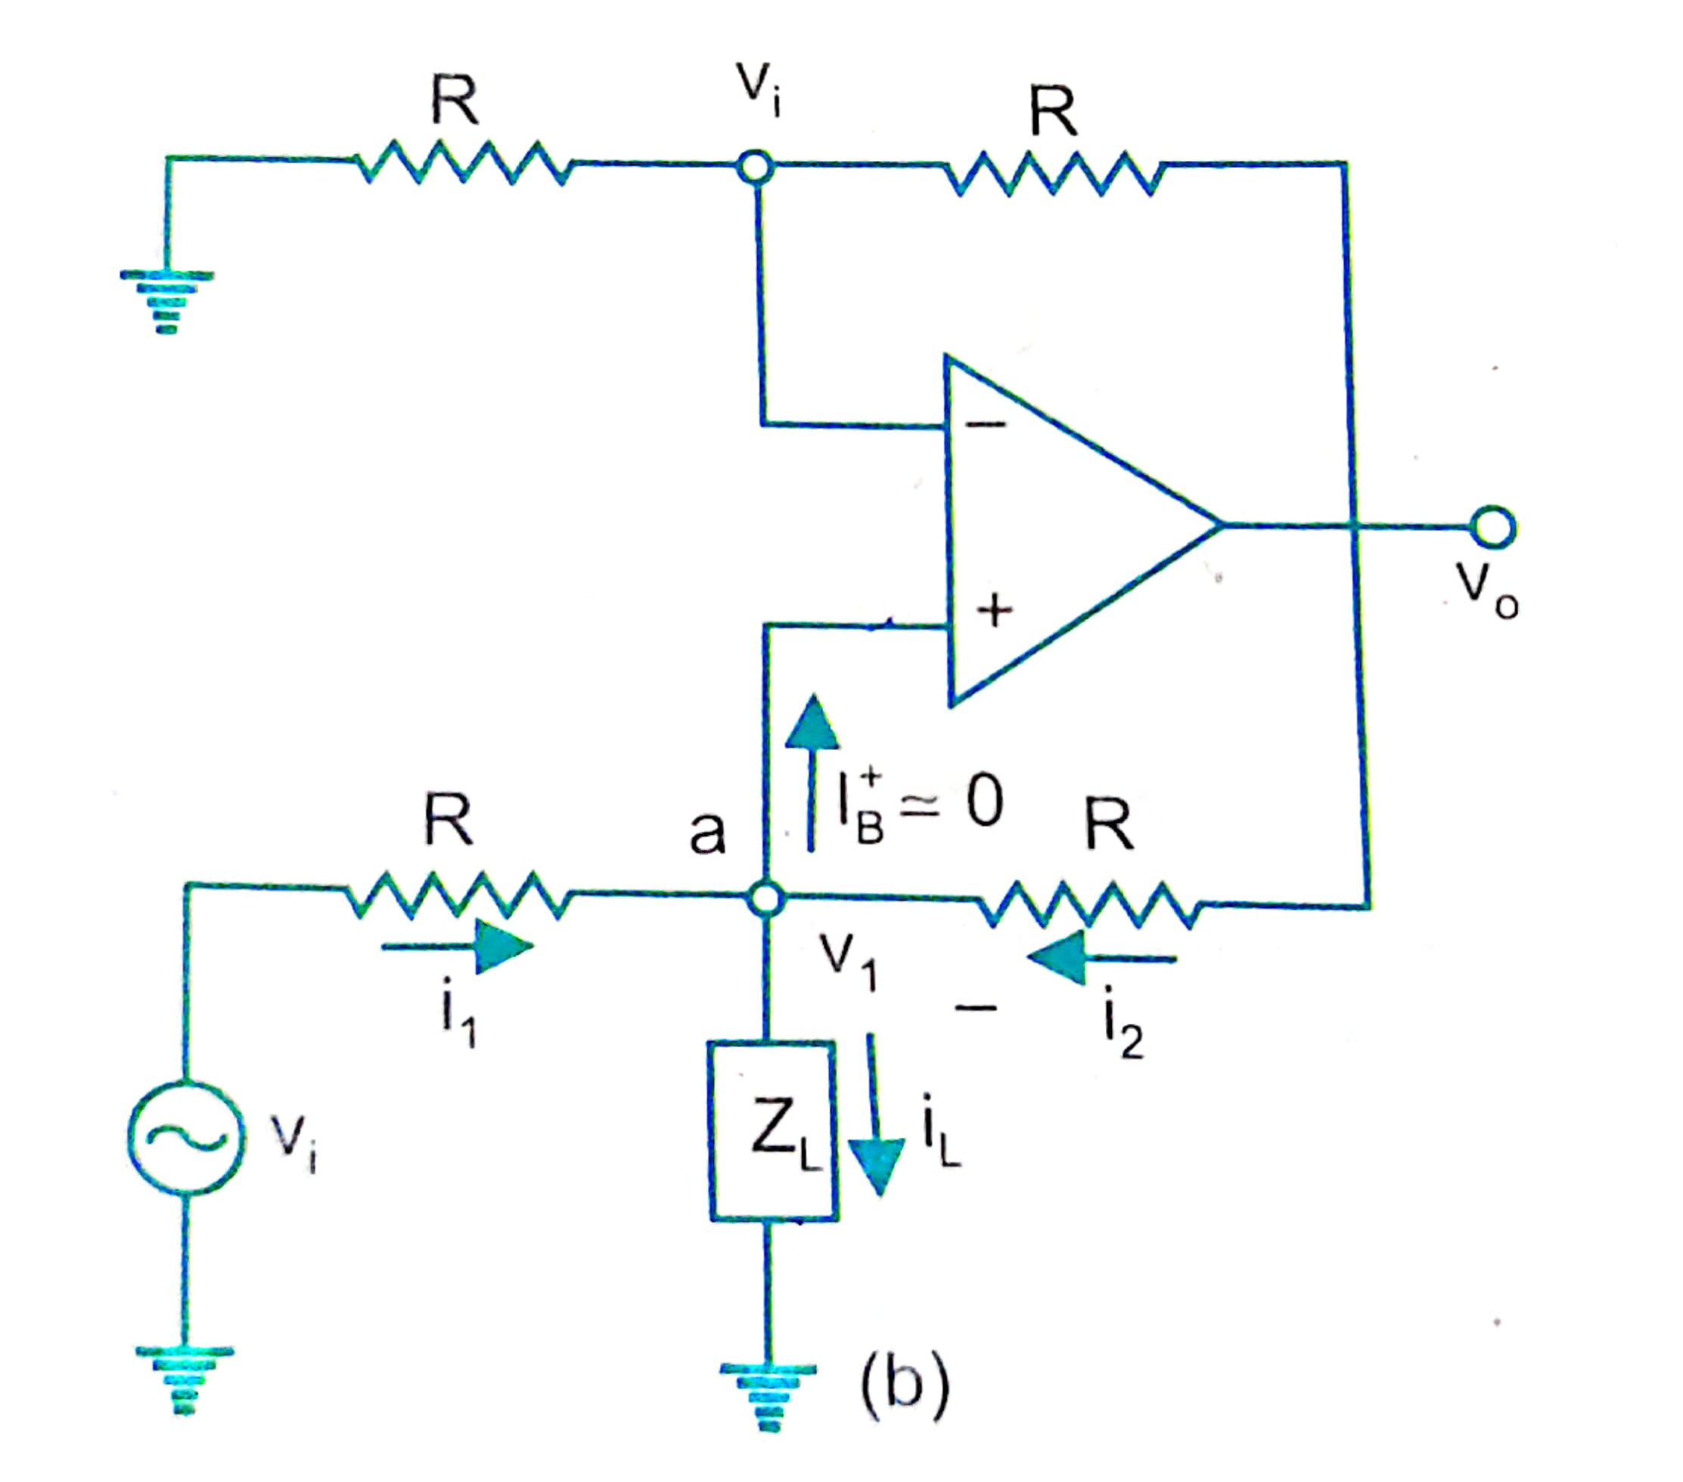
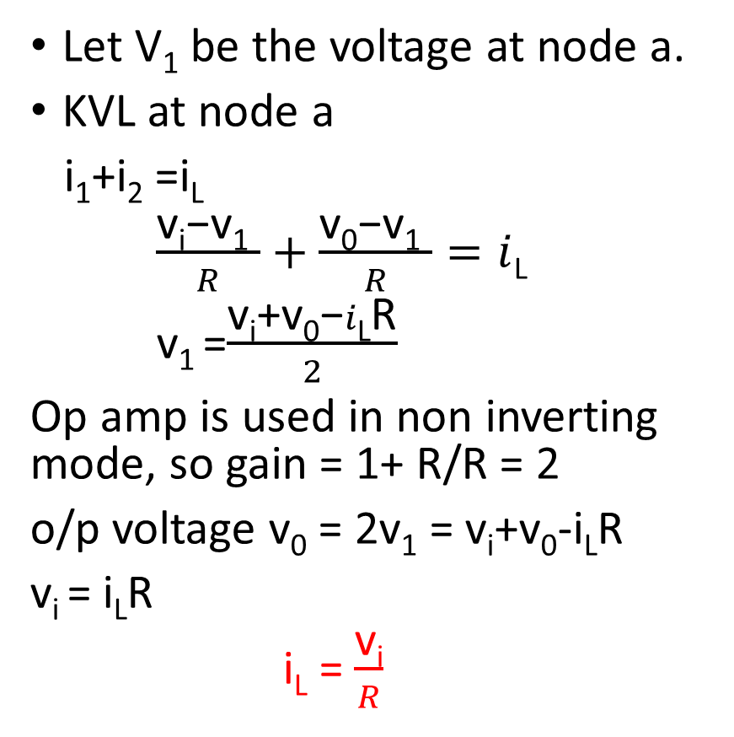
ii. V-I converter with grounded load
Let V₁ be the voltage at node a.
KVL at node a
i₁+i₂ =i_{L}
$\frac{\text{v}\text{i}\text{−}\text{v}\text{1} }{R}+\frac{\text{v}\text{0}\text{−}\text{v}\text{1} }{R}=i$_{L}
v₁ =$\frac{\text{v}\text{i}\text{+}\text{v}\text{0}\text{−}i\text{L}\text{R}}{2}$
Op amp is used in non inverting mode, so gain = 1+ R/R = 2
o/p voltage v₀ = 2v₁ = v_{i}+v₀-i_{L}R
v_{i} = i_{L}R
i_{L} = $\frac{\text{v}\text{i}}{R}$

Slide 28
As the i/p impedance of a non inverting ampr is very high, this ckt has the advantage of drawing very little current from the source.
V to I converter is used for low voltage dc and ac voltmeter, LED and Zener diode tester.

Slide 29
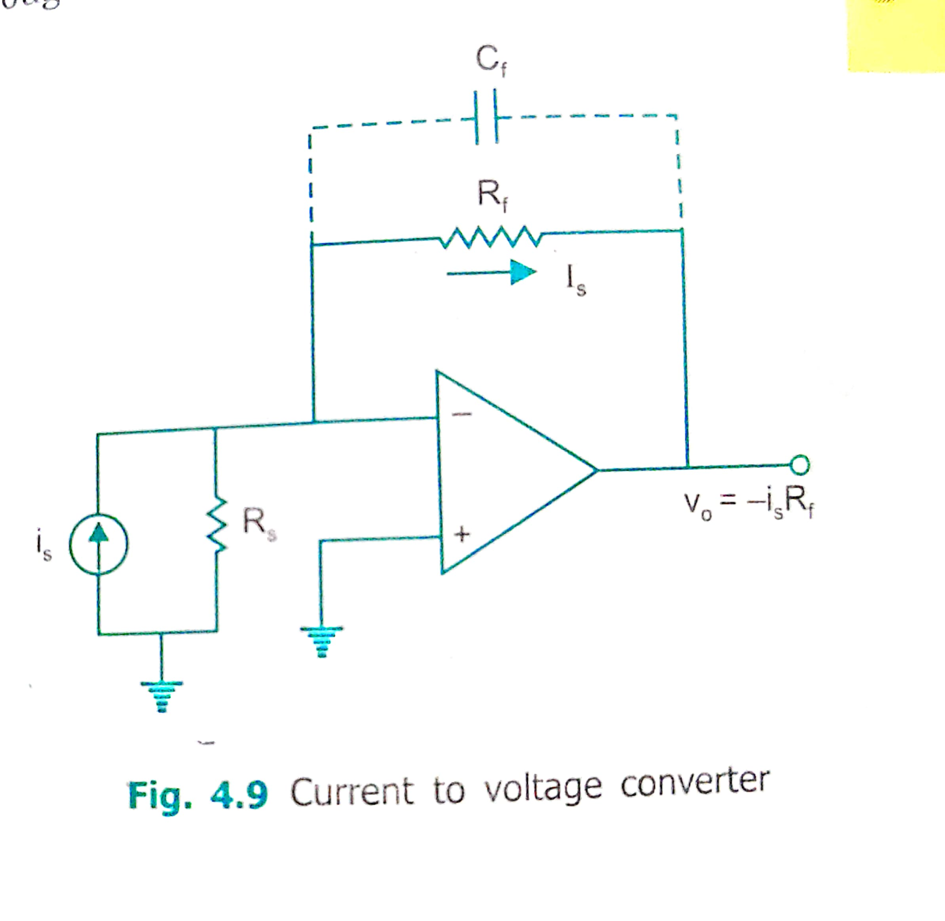
4.2. Current to voltage converter (Transresistance ampr)
Photo cell, photo diode and photo voltaic cell give an o/p that is proportional to an incident radiant energy or light.
Current through these devices can be converted to V by using a I to V converter & thereby the amnt of light or radiant energy incident on the photo device can be measured.
Here (-) i/p terminal is at virtual grnd.
So no current flows thru R_{s}.

Slide 30
i_{s} flows thru f/b res R_{f} .
o/p Voltage V₀ = -i_{s} R_{f}
Lowest current that this ckt can measure will depend upon bias current I_{B} of the op amp.
This means that µA741 (I_{B} = 3nA) can be used to detect lower currents.
R_{f} sometimes shunted with capacitor C_{f} to reduce high freq noise and the possibility of oscillations.

Slide 31
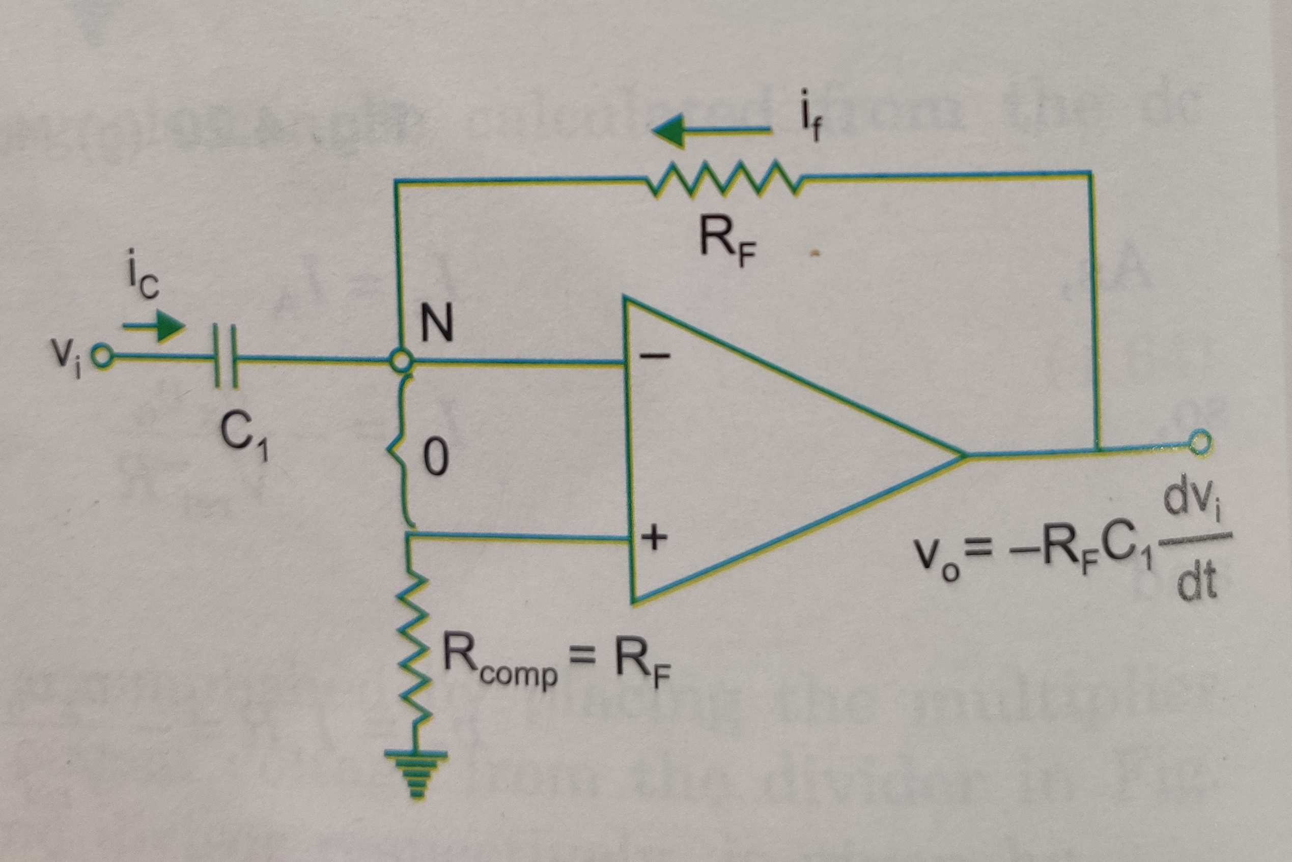
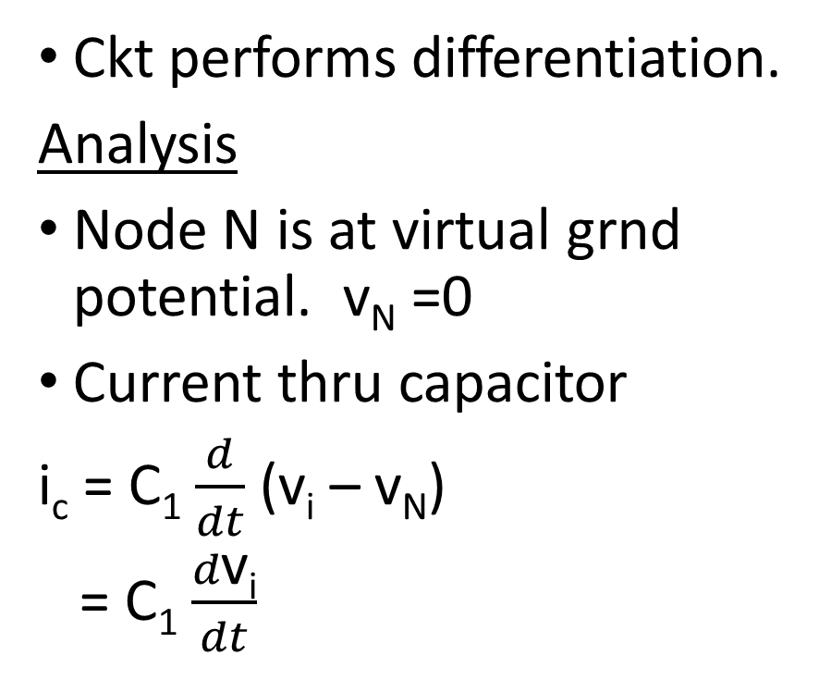
5. Differentiator
Ckt performs differentiation.
Analysis
Node N is at virtual grnd potential. v_{N} =0
Current thru capacitor
i_{c} = C₁ $\frac{d}{dt}$ (v_{i} – v_{N})
= C₁ $\frac{d\text{v}\text{i}}{dt}$

Slide 32
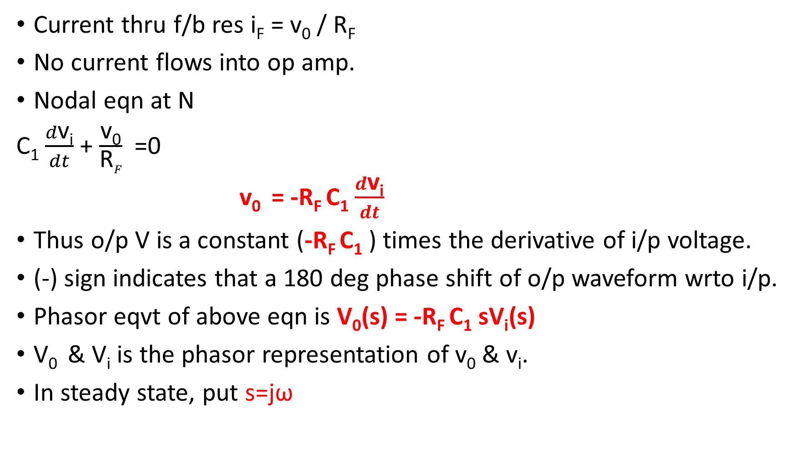
Current thru f/b res i_{F} = v₀ / R_{F}
No current flows into op amp.
Nodal eqn at N
C₁ $\frac{d\text{v}\text{i}}{dt}$ + $\frac{\text{v}\text{0}}{\text{R}F}$ =0
v₀ = -R_{F} C₁ $\frac{d\text{v}\text{i}}{dt}$
Thus o/p V is a constant (-R_{F} C₁ ) times the derivative of i/p voltage.
(-) sign indicates that a 180 deg phase shift of o/p waveform wrto i/p.
Phasor eqvt of above eqn is V₀(s) = -R_{F} C₁ sV_{i}(s)
V₀ & V_{i} is the phasor representation of v₀ & v_{i}.
In steady state, put s=jω

Slide 33
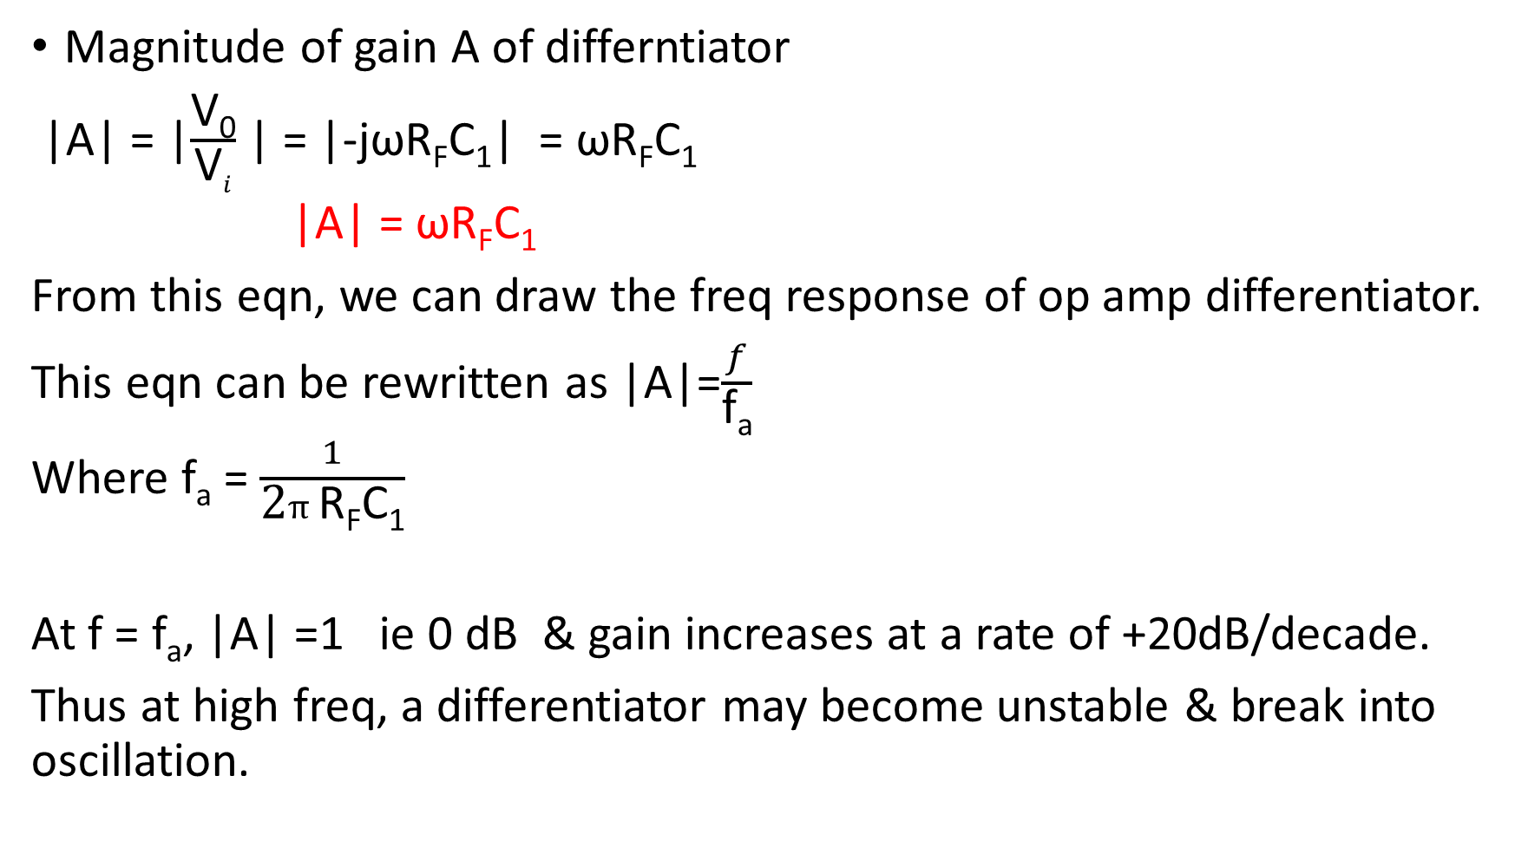
Magnitude of gain A of differntiator
|A| = |$\frac{\text{V}\text{0}}{\text{V}i}$ | = |-jωR_{F}C₁| = ωR_{F}C₁
|A| = ωR_{F}C₁
From this eqn, we can draw the freq response of op amp differentiator.
This eqn can be rewritten as |A|=$\frac{f}{\text{f}\text{a}}$
Where f_{a} = $\frac{1}{\text{2}π\text{R}\text{F}\text{C}\text{1}}$
At f = f_{a}, |A| =1 ie 0 dB & gain increases at a rate of +20dB/decade.
Thus at high freq, a differentiator may become unstable & break into oscillation.

Slide 34
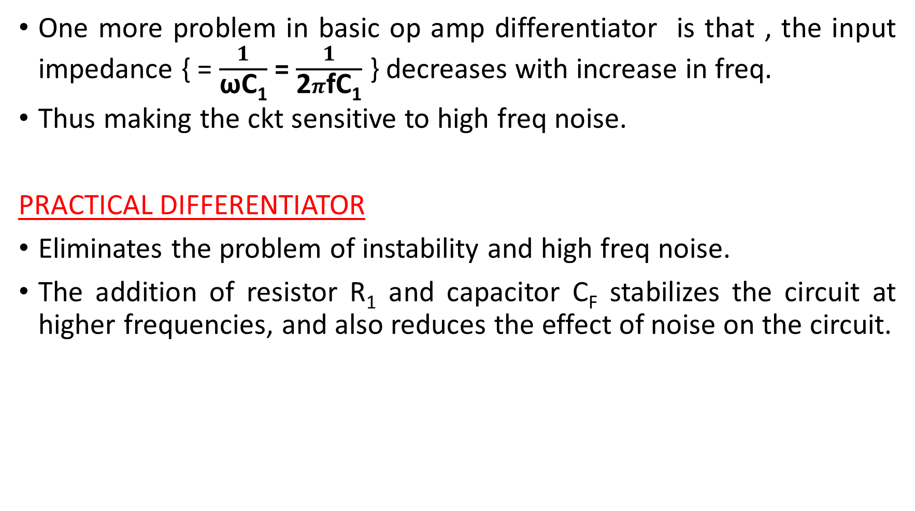
One more problem in basic op amp differentiator is that , the input impedance { = $\frac{1}{\text{ω}\text{C}\text{1}}$ = $\frac{1}{\text{2}π\text{f}\text{C}\text{1}}$ } decreases with increase in freq.
Thus making the ckt sensitive to high freq noise.
PRACTICAL DIFFERENTIATOR
Eliminates the problem of instability and high freq noise.
The addition of resistor R₁ and capacitor C_{F} stabilizes the circuit at higher frequencies, and also reduces the effect of noise on the circuit.

Slide 35
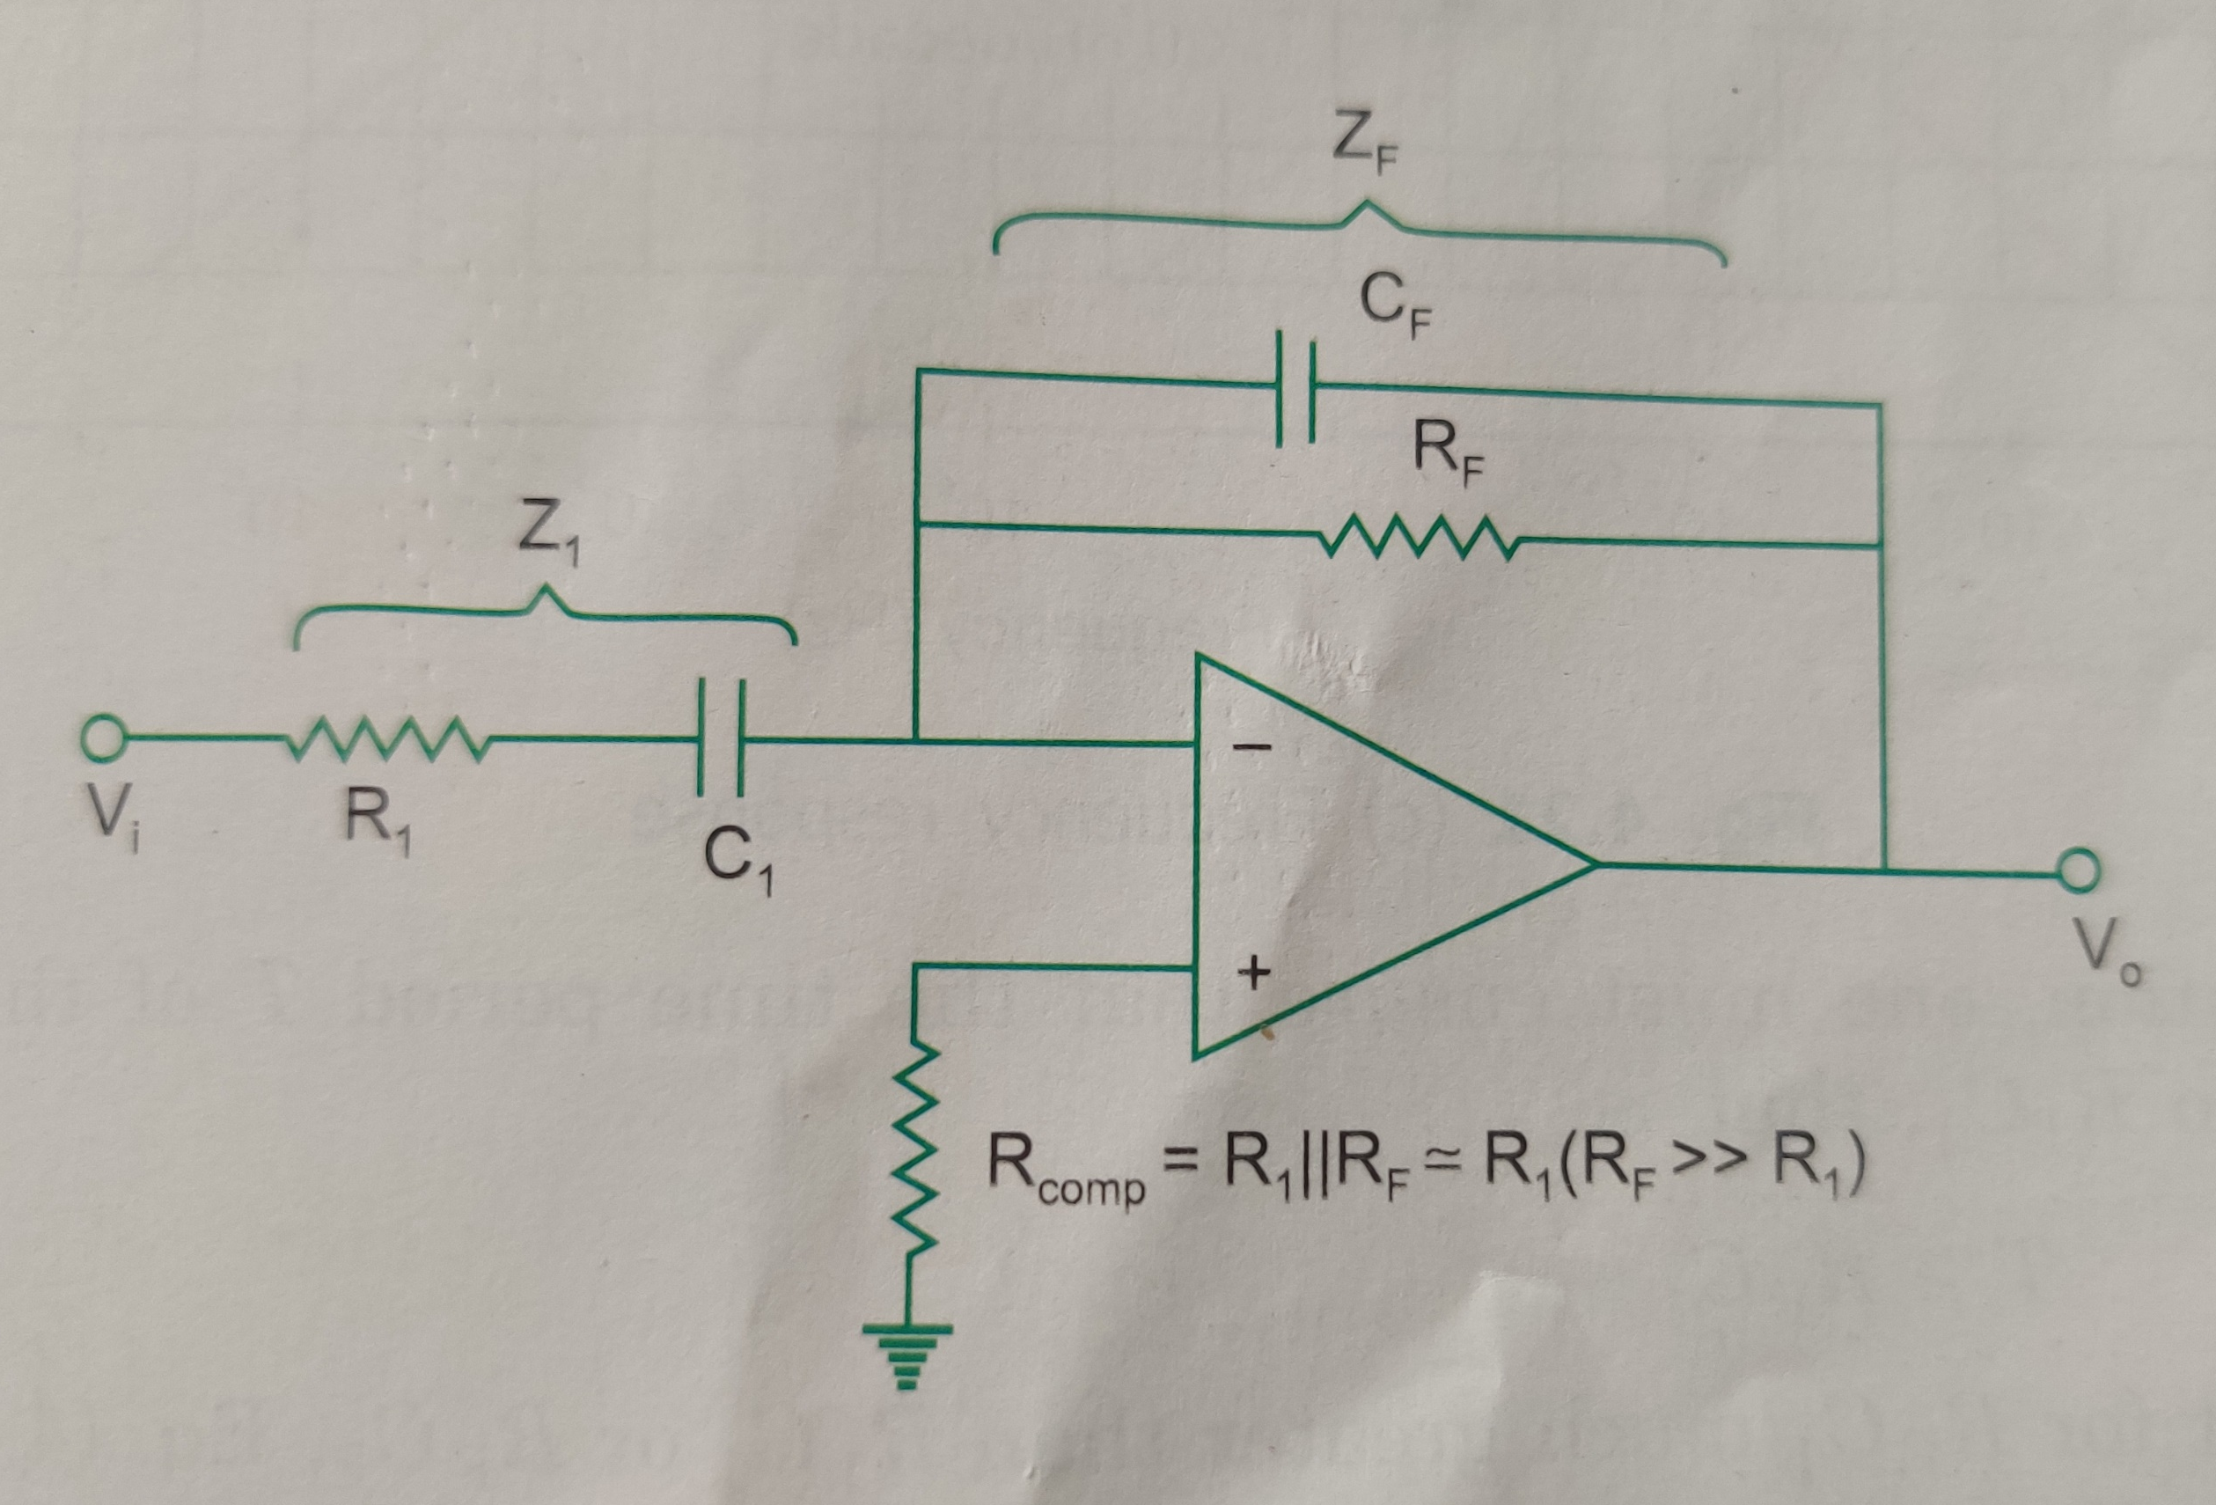
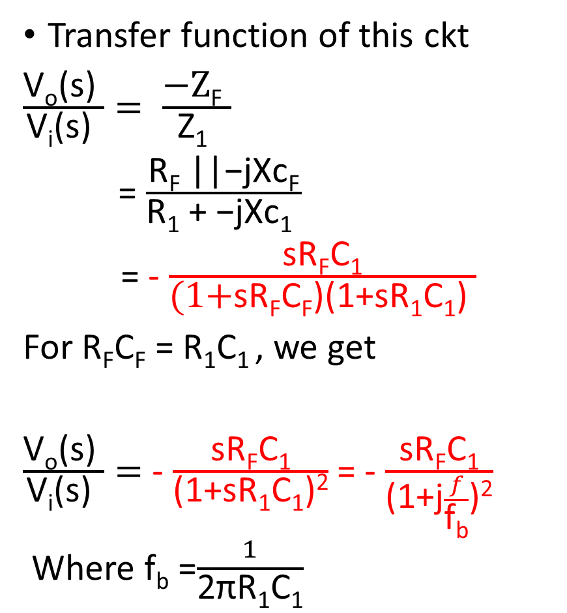
PRACTICAL DIFFERENTIATOR
Transfer function of this ckt
$\frac{\text{V}\text{o}\text{(}\text{s}\text{) }}{\text{V}\text{i}\text{(}\text{s}\text{) }}= \frac{\text{−}\text{Z}\text{F} }{\text{Z}\text{1} }$
= $\frac{\text{R}\text{F}\text{ ||−}\text{jX}\text{c}\text{F}}{\text{R}\text{1} \text{+ }\text{−}\text{jXc}\text{1} }$
= - $\frac{\text{sR}\text{F}\text{C}\text{1}}{\text{(1+}\text{sR}\text{F}\text{C}\text{F}\text{)(1+}\text{sR}\text{1}\text{C}\text{1}\text{) }}$
For $\text{R}\text{F}\text{C}\text{F}$ = $\text{R}\text{1}\text{C}\text{1 }$, we get
$\frac{\text{V}\text{o}\text{(}\text{s}\text{) }}{\text{V}\text{i}\text{(}\text{s}\text{) }}=$ - $\frac{\text{sR}\text{F}\text{C}\text{1}}{\text{(1+}\text{sR}\text{1}\text{C}\text{1}\text{)}\text{2}}$ = - $\frac{\text{sR}\text{F}\text{C}\text{1}}{\text{(1+}\text{j}\frac{f}{\text{f}\text{b}}\text{)}\text{2}}$
Where f_{b} =$\frac{1}{\text{2}\text{π}\text{R}\text{1}\text{C}\text{1}}$

Slide 36
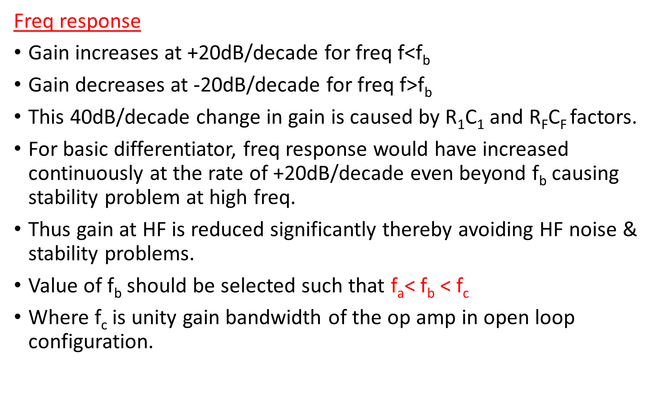
Freq response
Gain increases at +20dB/decade for freq f<f_{b}
Gain decreases at -20dB/decade for freq f>f_{b}
This 40dB/decade change in gain is caused by $\text{R}\text{1}\text{C}$₁ and $\text{R}\text{F}\text{C}$_{F} factors.
For basic differentiator, freq response would have increased continuously at the rate of +20dB/decade even beyond f_{b} causing stability problem at high freq.
Thus gain at HF is reduced significantly thereby avoiding HF noise & stability problems.
Value of f_{b} should be selected such that f_{a}< f_{b} < f_{c}
Where f_{c} is unity gain bandwidth of the op amp in open loop configuration.

Slide 37
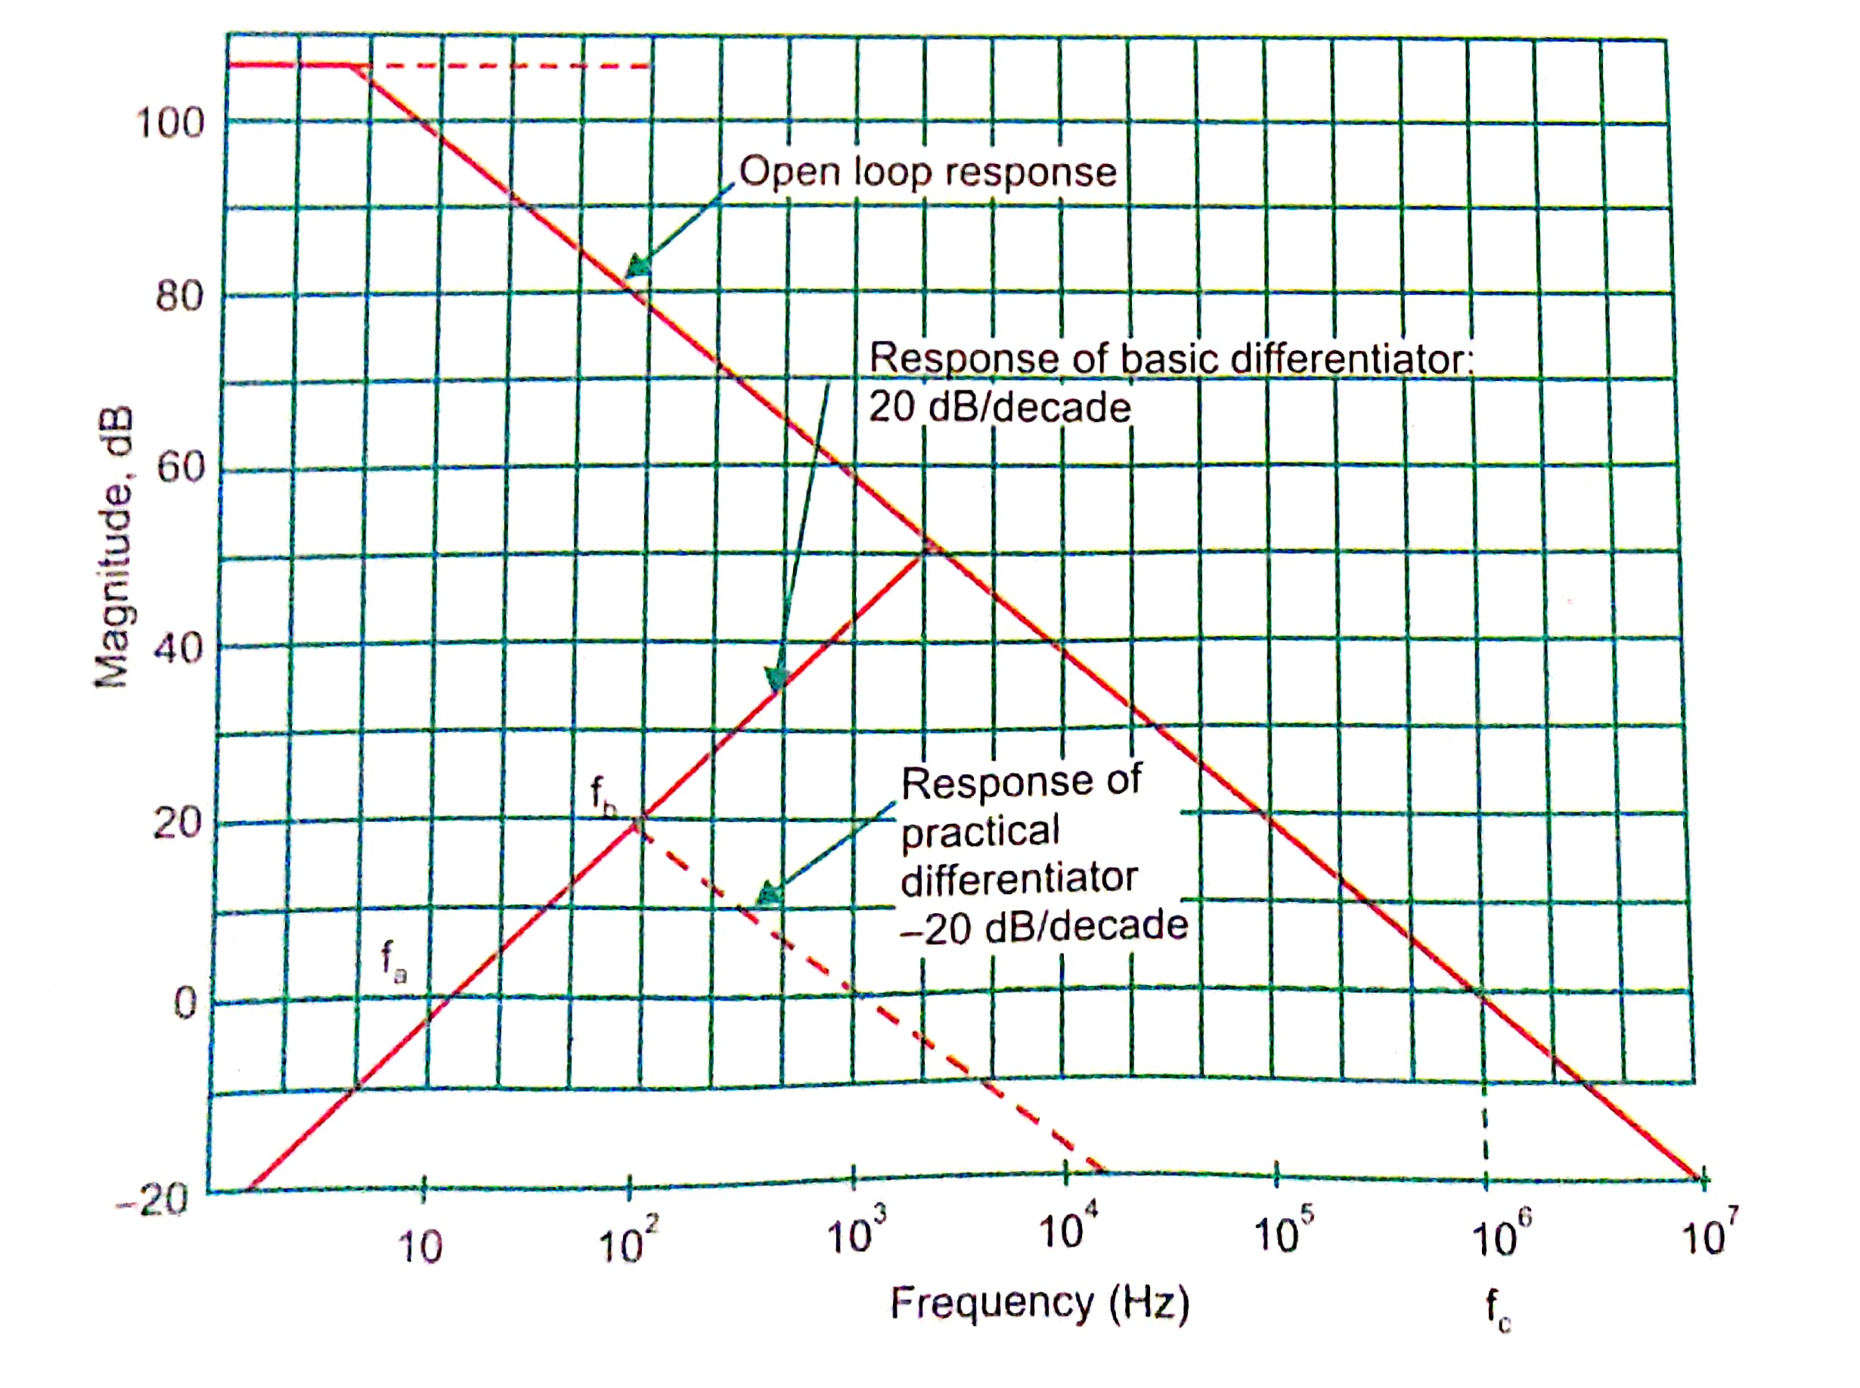
Freq response

Slide 38
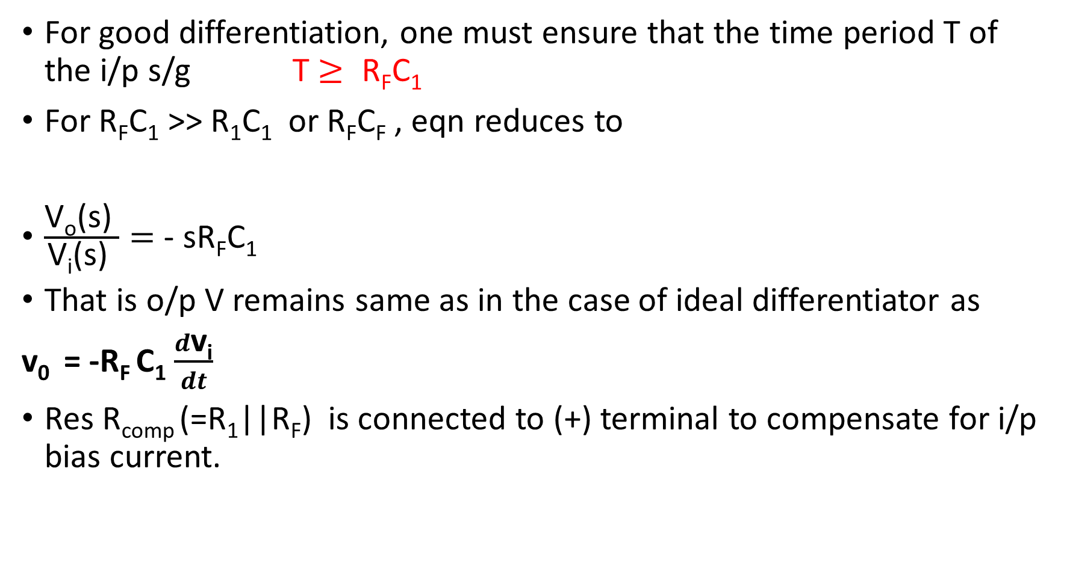
For good differentiation, one must ensure that the time period T of the i/p s/g T $≥ \text{R}\text{F}\text{C}\text{1}$
For $\text{R}\text{F}\text{C}\text{1}$ >> $\text{R}\text{1}\text{C}\text{1}$ or $\text{R}\text{F}\text{C}\text{F}$ , eqn reduces to
$\frac{\text{V}\text{o}\text{(}\text{s}\text{) }}{\text{V}\text{i}\text{(}\text{s}\text{) }}=$ - $\text{sR}\text{F}\text{C}\text{1}$
That is o/p V remains same as in the case of ideal differentiator as
v₀ = -R_{F} C₁ $\frac{d\text{v}\text{i}}{dt}$
Res R_{comp} (=R₁||R_{F}) is connected to (+) terminal to compensate for i/p bias current.

Slide 39
A good differentiator may be designed as per following steps :
Choose f_{a} equal to highest freq of i/p s/g. Assume a practical value of C₁ (<1µF) and then calculate R_{F} .
Choose f_{b}=10 f_{a} (say). Now calculate values of R₁ and C_{F} so that R₁C₁ = R_{F}C_{F}

Slide 40
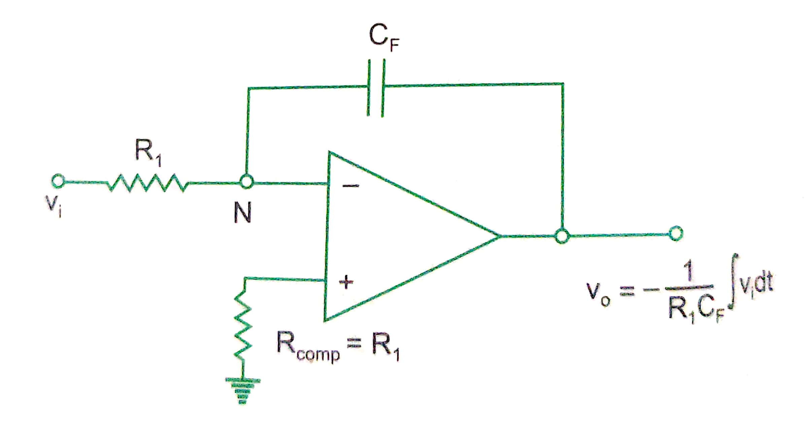
6. Integrator

Slide 41
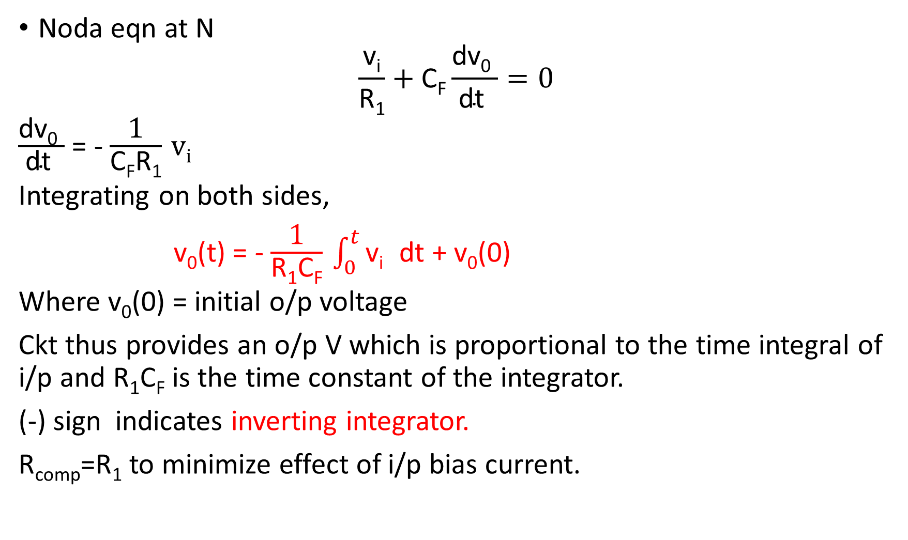
Noda eqn at N
$$\frac{\text{v}\text{i}}{\text{R}\text{1}}+\text{C}\text{F}\frac{\text{dv}\text{0} }{\text{d}\text{t} }=0$$
$\frac{\text{dv}\text{0} }{\text{d}\text{t} }$ = - $\frac{\text{1}}{\text{C}\text{F}\text{R}\text{1}}$v_{i}
Integrating on both sides,
v₀(t) = - $\frac{\text{1}}{\text{R}\text{1}\text{C}\text{F}} \int_{0}^{t}{\text{v}\text{i} }$ dt + v₀(0)
Where v₀(0) = initial o/p voltage
Ckt thus provides an o/p V which is proportional to the time integral of i/p and $\text{R}\text{1}\text{C}\text{F}$ is the time constant of the integrator.
(-) sign indicates inverting integrator.
R_{comp}=R₁ to minimize effect of i/p bias current.

Slide 42
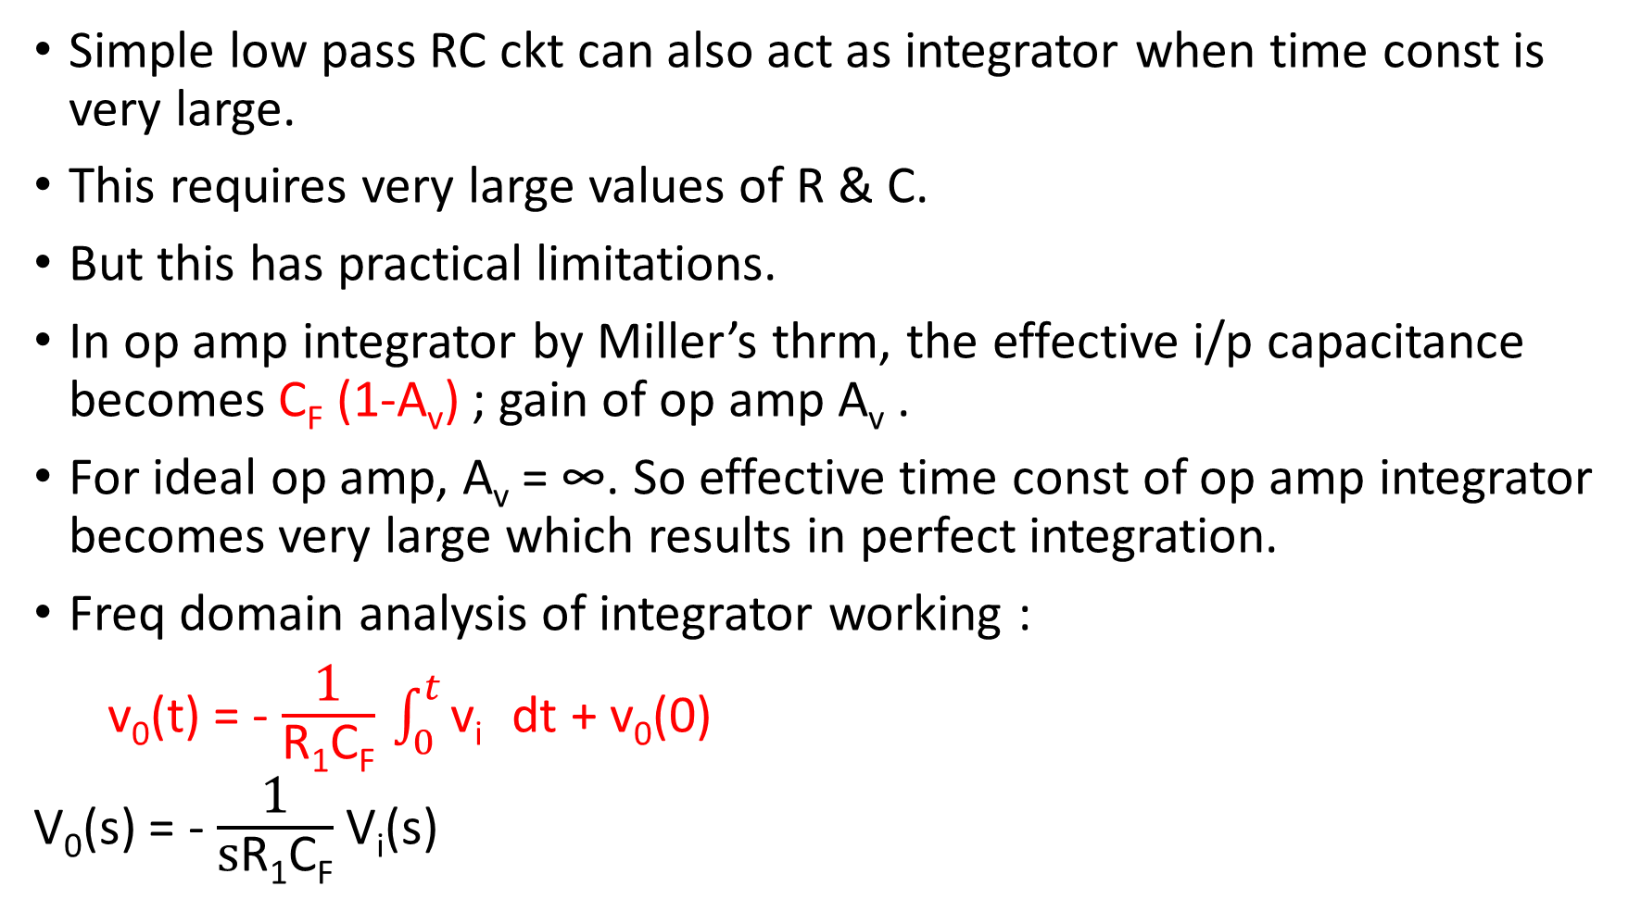
Simple low pass RC ckt can also act as integrator when time const is very large.
This requires very large values of R & C.
But this has practical limitations.
In op amp integrator by Miller’s thrm, the effective i/p capacitance becomes C_{F} (1-A_{v}) ; gain of op amp A_{v} .
For ideal op amp, A_{v} = ∞. So effective time const of op amp integrator becomes very large which results in perfect integration.
Freq domain analysis of integrator working :
v₀(t) = - $\frac{\text{1}}{\text{R}\text{1}\text{C}\text{F}} \int_{0}^{t}{\text{v}\text{i} }$ dt + v₀(0)
V₀(s) = - $\frac{\text{1}}{\text{s}\text{R}\text{1}\text{C}\text{F}}$ V_{i}(s)

Slide 43
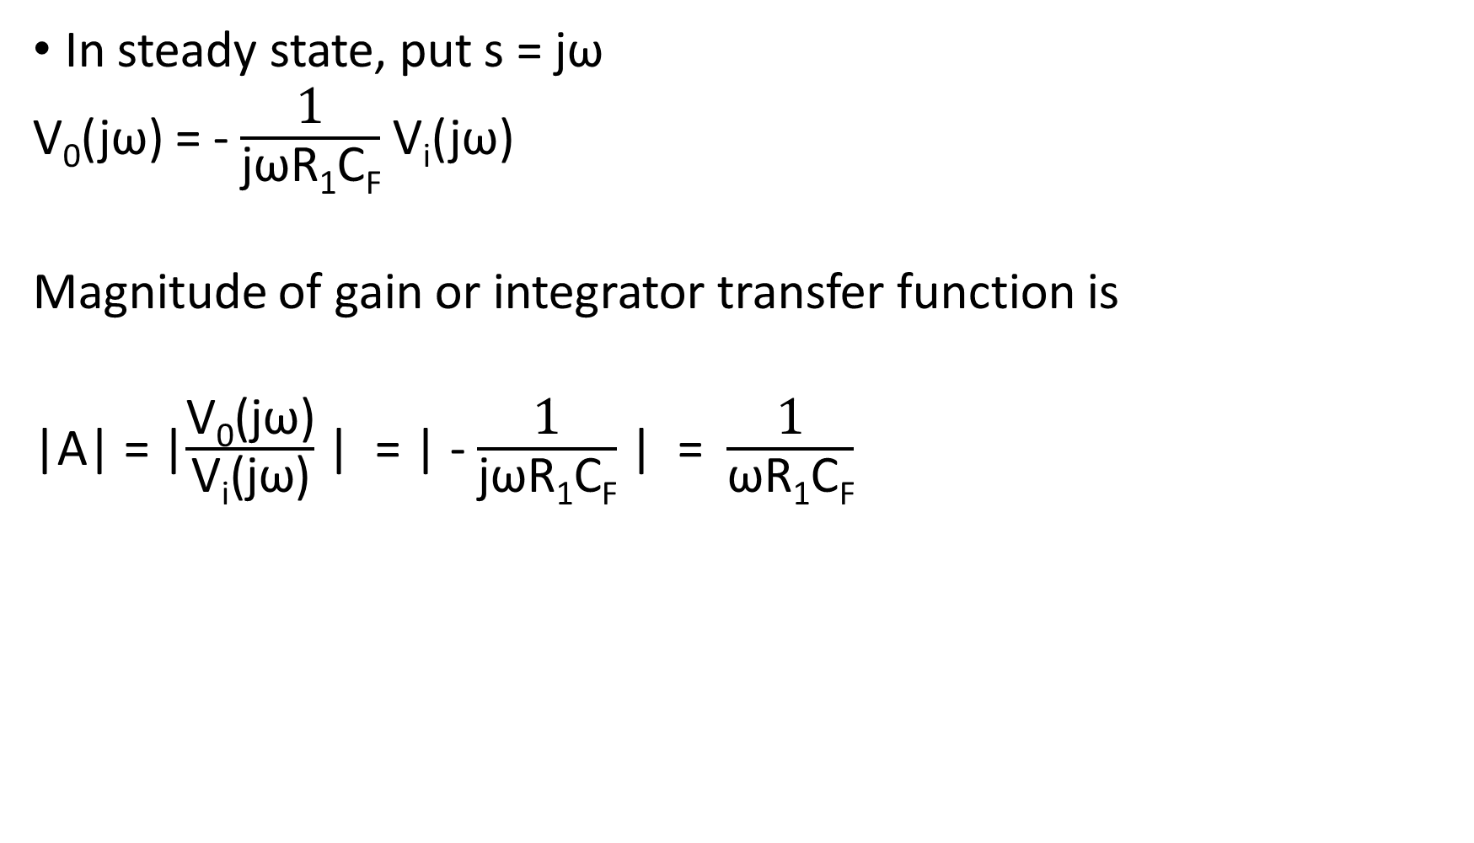
In steady state, put s = jω
V₀(jω) = - $\frac{\text{1}}{\text{j}\text{ω}\text{R}\text{1}\text{C}\text{F}}$ V_{i}(jω)
Magnitude of gain or integrator transfer function is
|A| = |$\frac{\text{V}\text{0}\text{(}\text{j}\text{ω}\text{)}}{\text{V}\text{i}\text{(}\text{j}\text{ω}\text{)}}$ | = | - $\frac{\text{1}}{\text{j}\text{ω}\text{R}\text{1}\text{C}\text{F}}$ | = $\frac{\text{1}}{\text{ω}\text{R}\text{1}\text{C}\text{F}}$

Slide 44
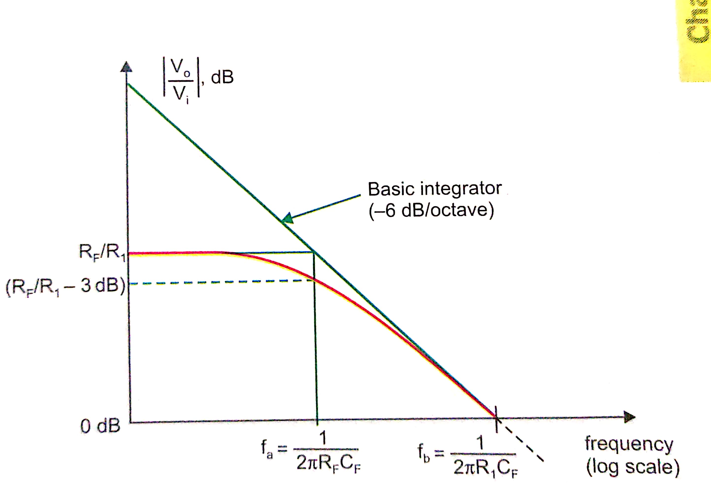
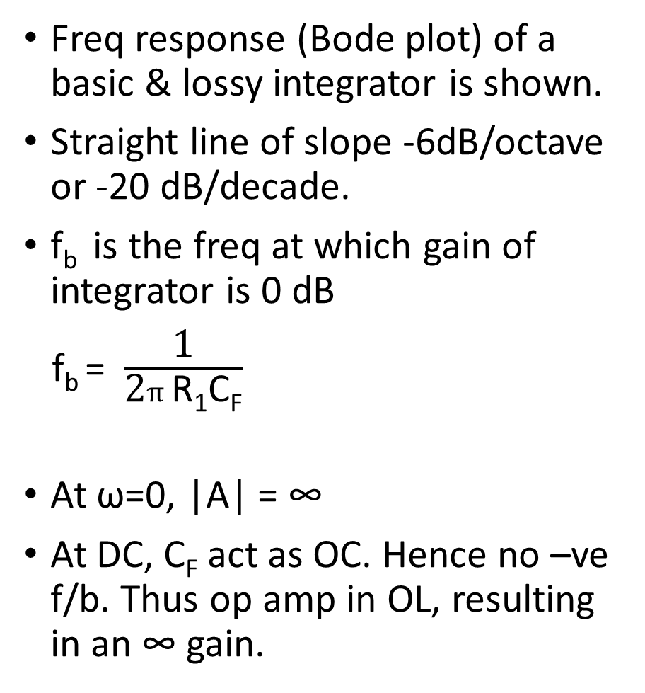
Freq response (Bode plot) of a basic & lossy integrator is shown.
Straight line of slope -6dB/octave or -20 dB/decade.
f_{b} is the freq at which gain of integrator is 0 dB
f_{b} = $\frac{\text{1}}{\text{2}π\text{R}\text{1}\text{C}\text{F}}$
At ω=0, |A| = ∞
At DC, C_{F} act as OC. Hence no –ve f/b. Thus op amp in OL, resulting in an ∞ gain.

Slide 45
Practically o/p never becomes ∞
o/p of ampr saturates at a voltage close to ± power supply of op amp depending on the polarity of i/p dc s/g.
As the gain of integrator decreases with increasing freq, integrator ckt doesnot have any freq problem as faced in a differentiator.
But at low freqs such as at dc (ω ≈ 0), the gain becomes ∞ or saturates.

Slide 46

Practical integrator ckt( Lossy integrator)
Gain of integrator at low freq (dc) can be limited to avoid the saturation problem if the f/b cap. is shunted by a res R_{F}.
Parallel combination of R_{F} & C_{F} behaves like a practical capacitor which dissipates power unlike an ideal capacitor.
Bcoz of this, it is called as lossy integrator.

Slide 47

R_{F} limits low freq gain to –R_{F} /R₁ (generally R_{F}=10 R₁) & thus provides dc stabilization.
Analysis
Nodal eqn at inverting terminal of op amp
$\frac{\text{V}\text{i}\text{(}\text{s}\text{) }}{\text{R}\text{1} }+s\text{C}\text{F} \text{V}\text{0}\text{(}\text{s}\text{)}\text{ +}\frac{\text{V}\text{0}\text{(}\text{s}\text{) }}{\text{R}\text{F} }=0$
$\text{V}\text{0}\text{(}\text{s}\text{)}\text{ = }$ - $\frac{\text{1}}{\text{s}\text{R}\text{1}\text{C}\text{F} + \frac{\text{R}\text{1} }{\text{R}\text{F} } }$ $\text{V}\text{i}\text{(}\text{s}\text{)}$
If R_{F} is very large, lossy integrator approximates ideal integrator.
For s=jω, magnitude of gain of lossy intregrator
|A| = |$\frac{\text{V}\text{0}}{\text{V}\text{i}}$ | = $\frac{1}{\sqrt{\text{ω}\text{2} \text{R}\text{1}\text{2 }\text{C}\text{F}\text{2}+{ \text{R}\text{1}\text{2}}/{\text{R}\text{F}\text{2}}}}$ = $\frac{\frac{\text{R}\text{F} }{\text{R}\text{1} }}{\sqrt{\text{1+(}\text{ω}\text{R}\text{F}\text{C}\text{F}\text{)}\text{2}}}$

Slide 48

Bode plot :
At low freqs, gain is const at R_{F} / R_{1.}
Break freq (f=f_{a}) at which gain is 0.707 (R_{F} / R₁) or -3dB below its value of R_{F} / R₁ is calculated as
|A| = |$\frac{\text{V}\text{0}}{\text{V}\text{i}}$ | = $\frac{\frac{\text{R}\text{F} }{\text{R}\text{1} }}{\sqrt{\text{1+(}\text{ω}\text{R}\text{F}\text{C}\text{F}\text{)}\text{2}}}$ = $\frac{1}{\sqrt{\text{2}}}$ $\frac{\text{R}\text{F} }{\text{R}\text{1} }$
$\sqrt{\text{1+(}\text{ω}\text{R}\text{F}\text{C}\text{F}\text{)}\text{2}}$ = $\sqrt{\text{2}}$
Solving for f=f_{a} , we get f_{a} = $\frac{\text{1}}{\text{2}π\text{R}\text{F}\text{C}\text{F}}$

Slide 49
This freq is very important as it tells us where the useful integration range starts,
If i/p freq is < f_{a} ,ckt acts like a simple inverting ampr and no integration results.
At i/p freq = f_{a} , 50% accuracy results.
The practical thumb rule is that if i/p freq is 10 times f_{a} , then 99% accuracy can be obtained.

